Slide 1
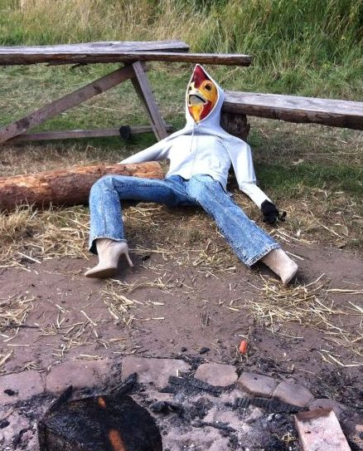
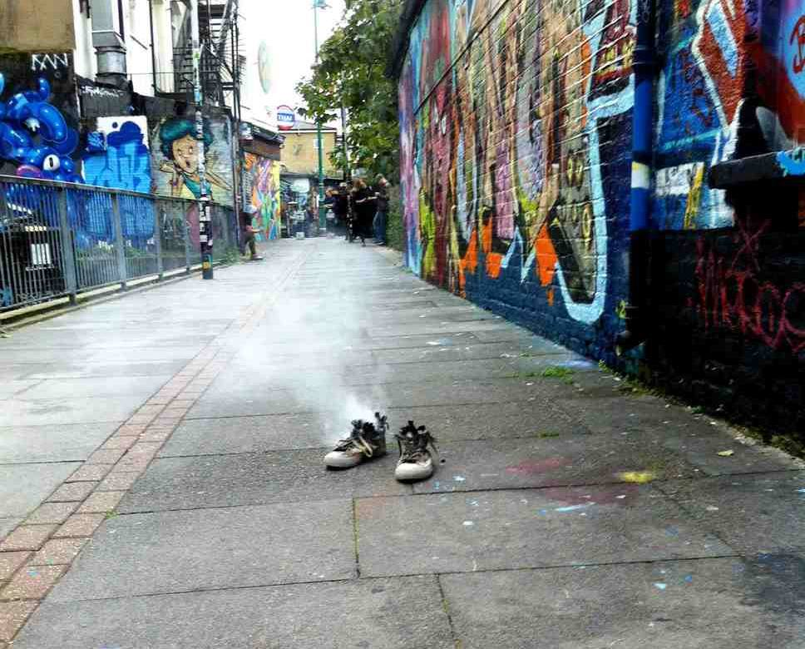
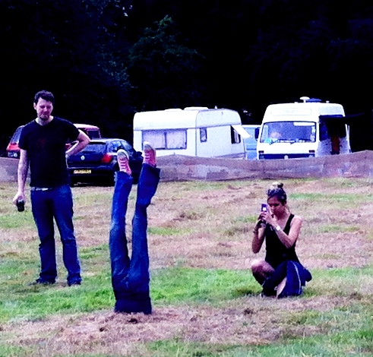
Truth, & fabrication based on the “real”
Image courtesy of Pier Corona
I do Construction rather than casting
… so far
Real materials: real clothes, real Earth

Slide 2
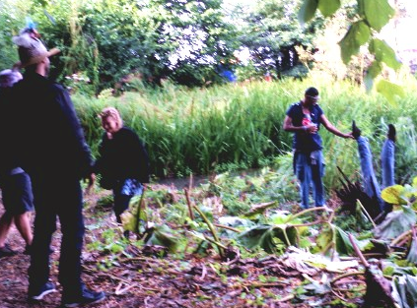
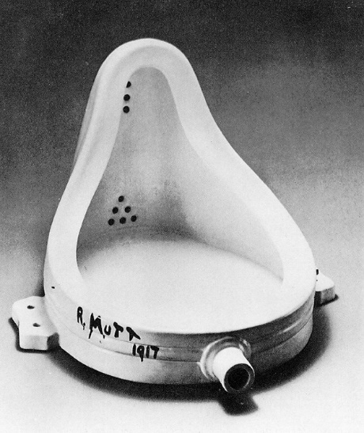
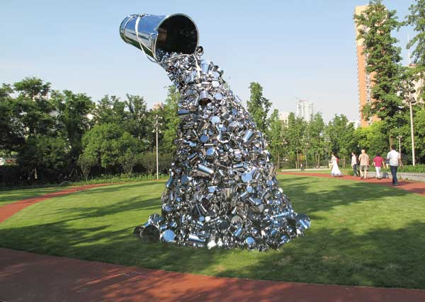
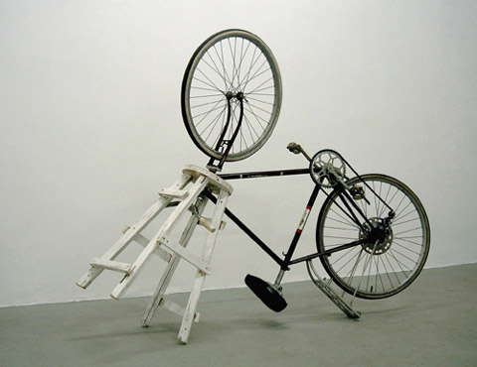
Some false dichotomies… (Where do I fit?)
Real materials (craft) vs sculptural casts (art) “representational” vs “is”
Real Artist vs craftsman
“Anyone can do that. Real sculptors use bronze and stone”
Thus: Real artists don’t use real materials. Bronze and stone are craftsmanship, so real artists are distinguished from craftsmen by… displaying craftsmanship.
Real artists are identified by making works that are representational, not actual.
1) The dichotomies are inconsistent. 2) Whose rules? ….and 3) ….. PTO

Slide 3
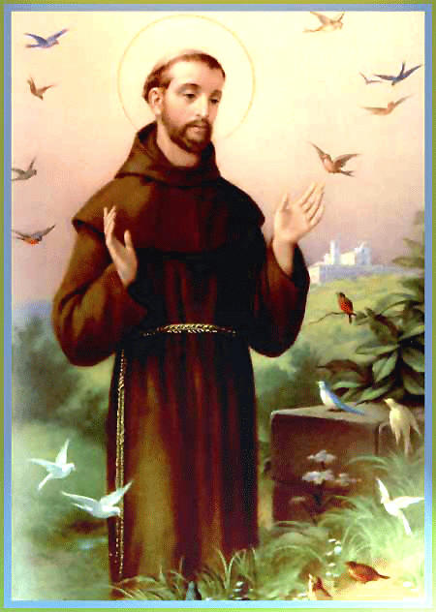
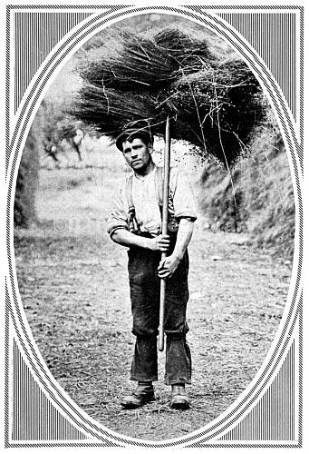
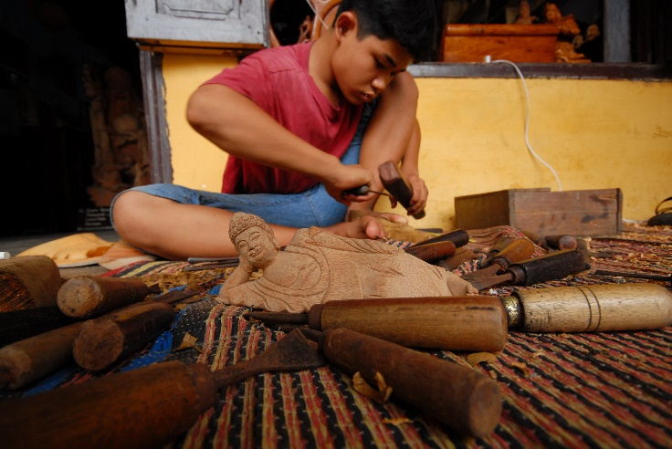
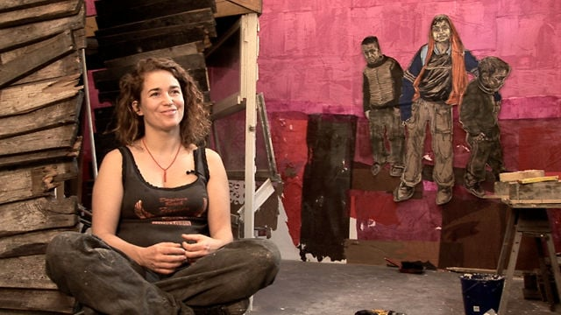
St Francis of Assisi
If you work with your hands, then you are a labourer.
If you work with your hands
and your mind,
then you are
a craftsman.
printsplace.co.uk fomr The Sphere, 1913
commons.wikimedia.org
If you work with your hands, and your mind, and your heart, then you are an artist.
Swoon. Interview with Louis Mitchell and Michael Danischewski

Slide 4
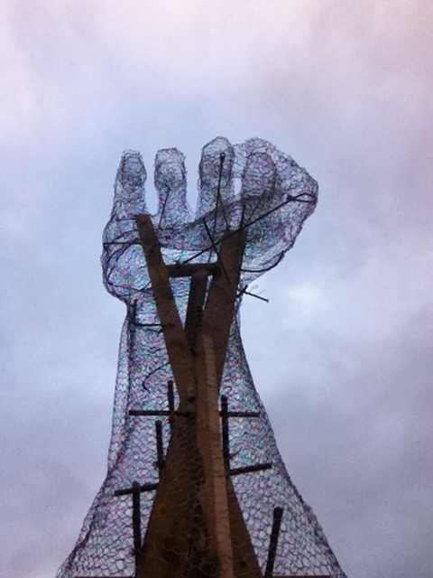
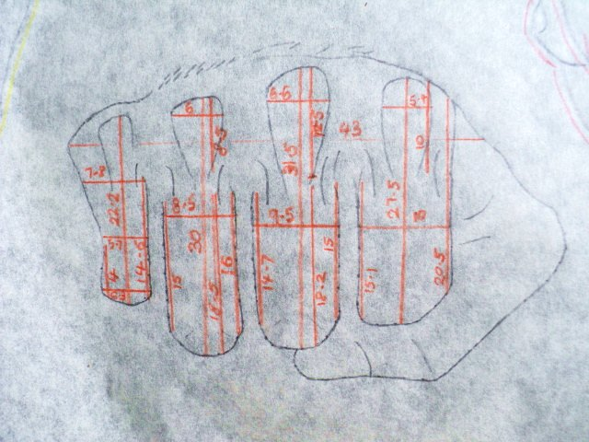
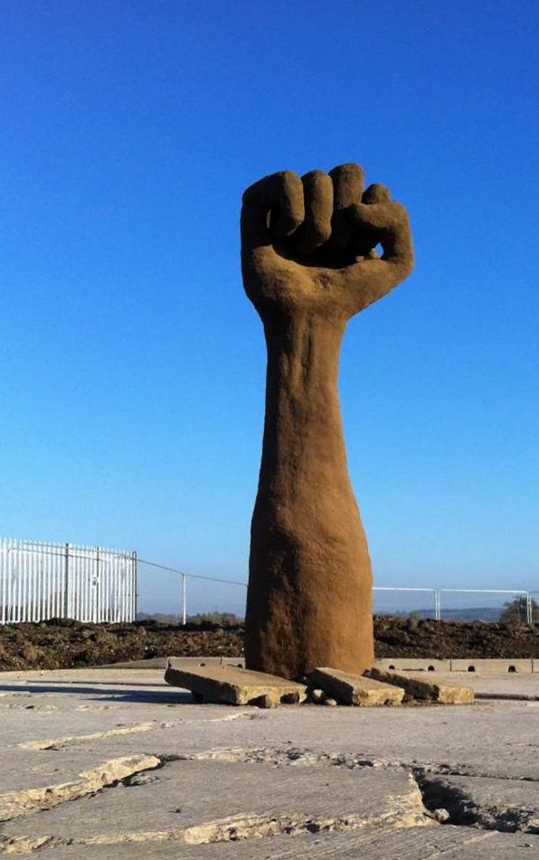
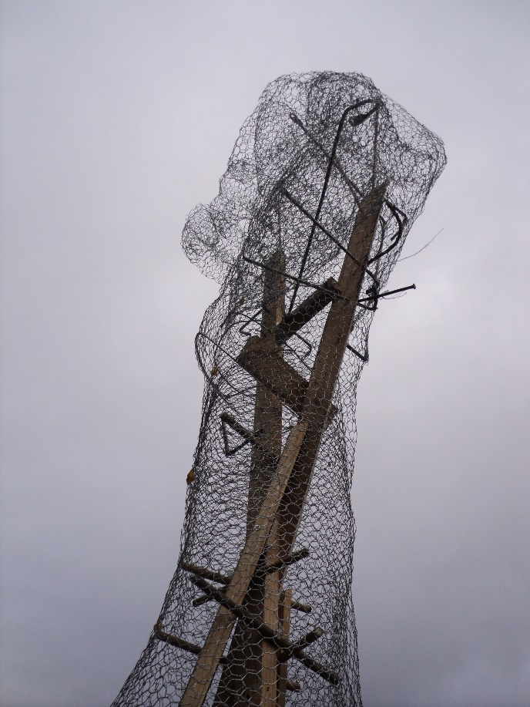
Growth

Slide 5
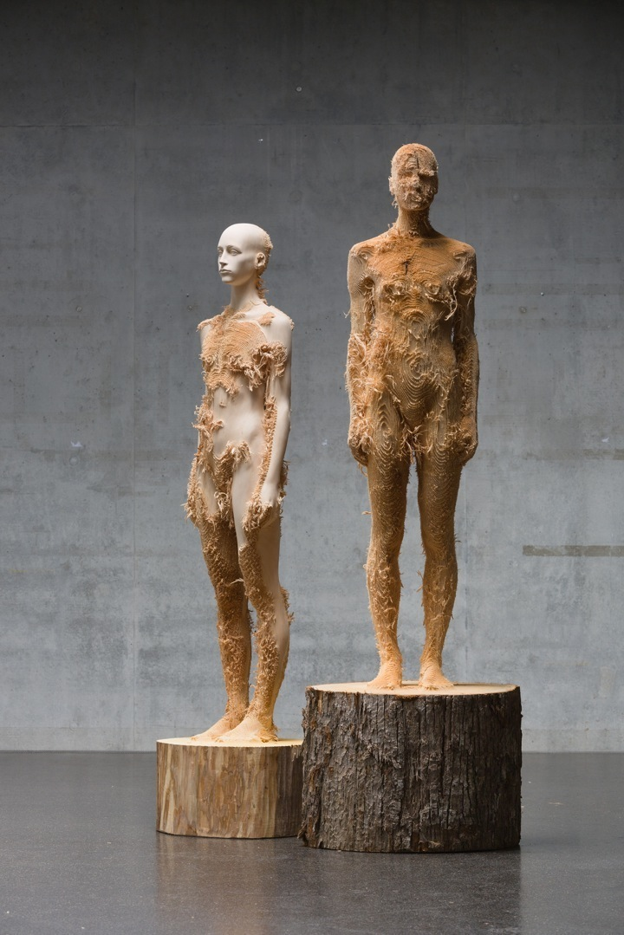
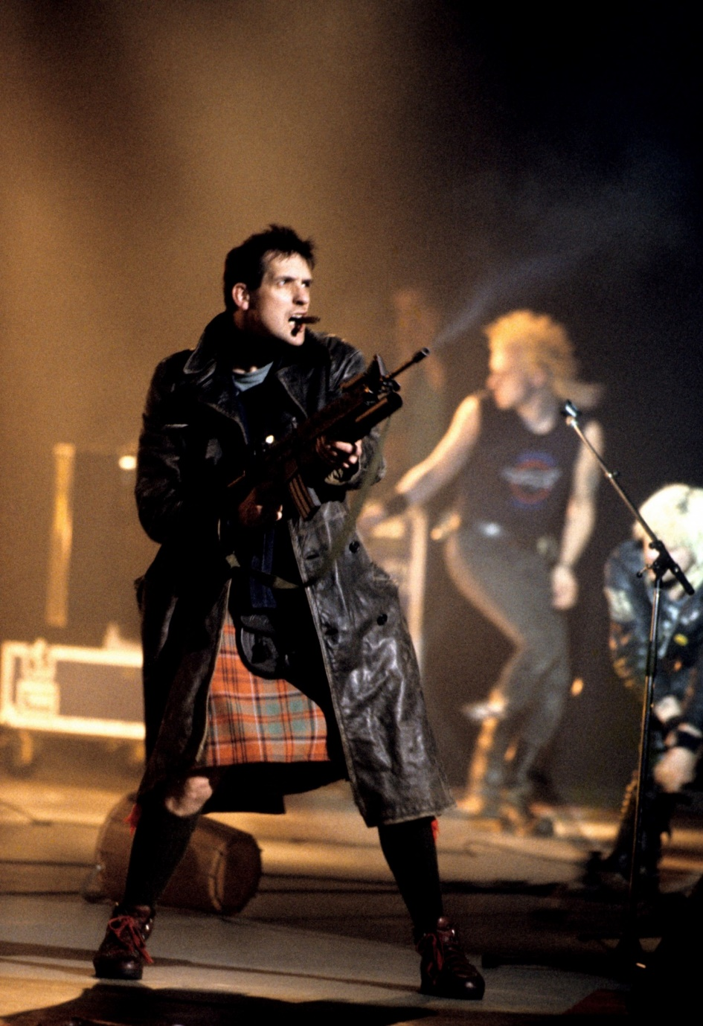
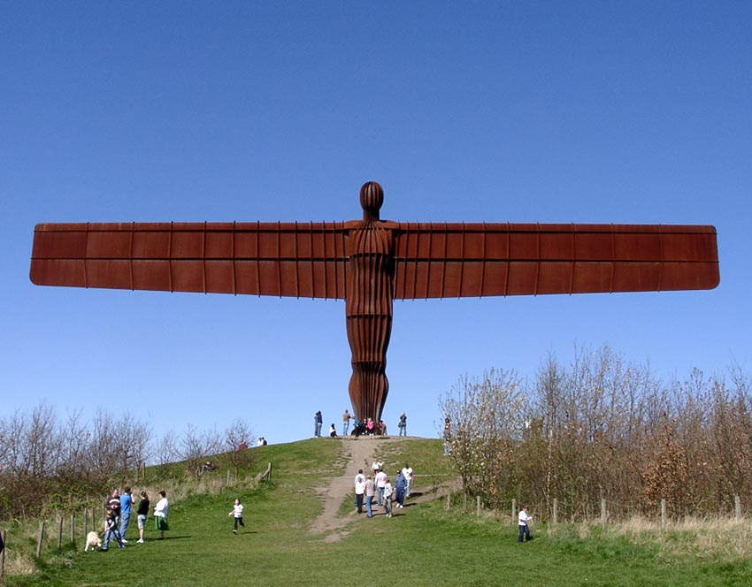
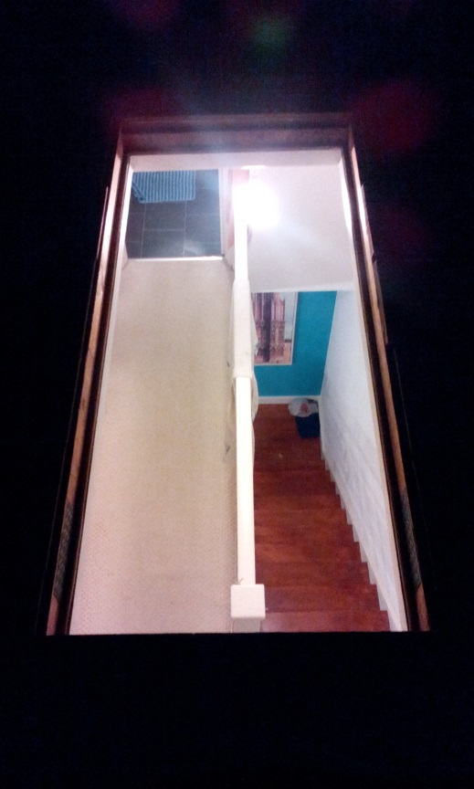
Scale
…. The Angel of the North ….. spectacular,
stunning, amazing – big, very big.
…. doubts… the only thing impressive about
The Angel of the North was its size.
…. imagine the statue no bigger than myself
…. and to my eyes what I saw was not a great
work of art.
…. then I decided not to make work bigger than
myself.
…. nothing I do should have its worth or
influence based on its scale – its
ability to bully.
Bill Drummond, KLF, K Foundation
image © Aron Demetz, sculptor
nearthesea.co.uk

Slide 6
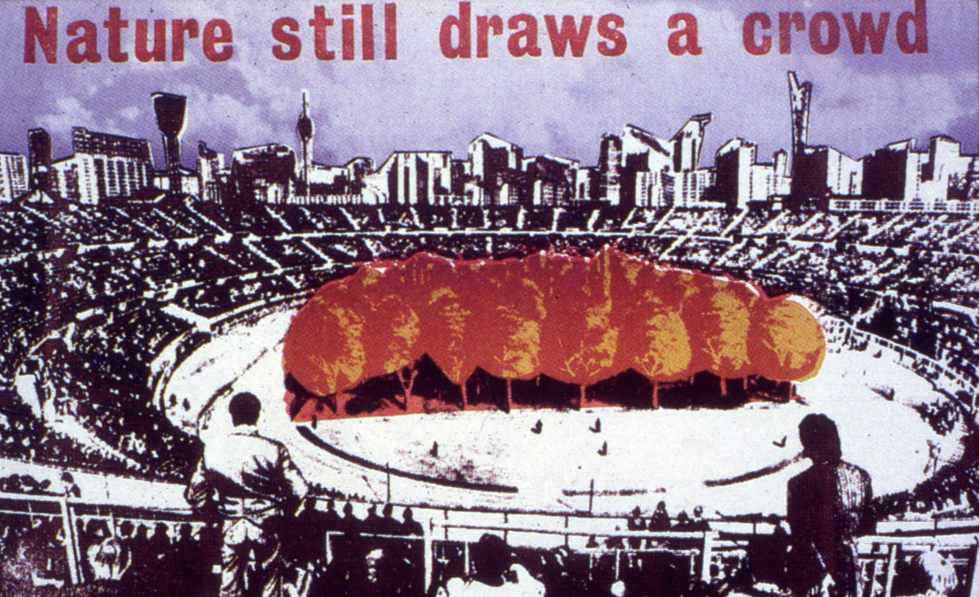
Sculpture must be as interesting as reality
by Jamie Reid, 1975, copied from
Max Peintner, Die ungebrochene Anziehungskraft der Natur (Nature still draws a crowd) pencil drawing 1970/71

Slide 7
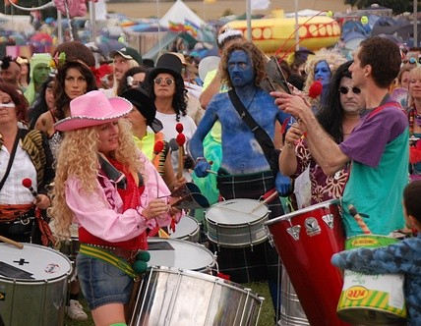
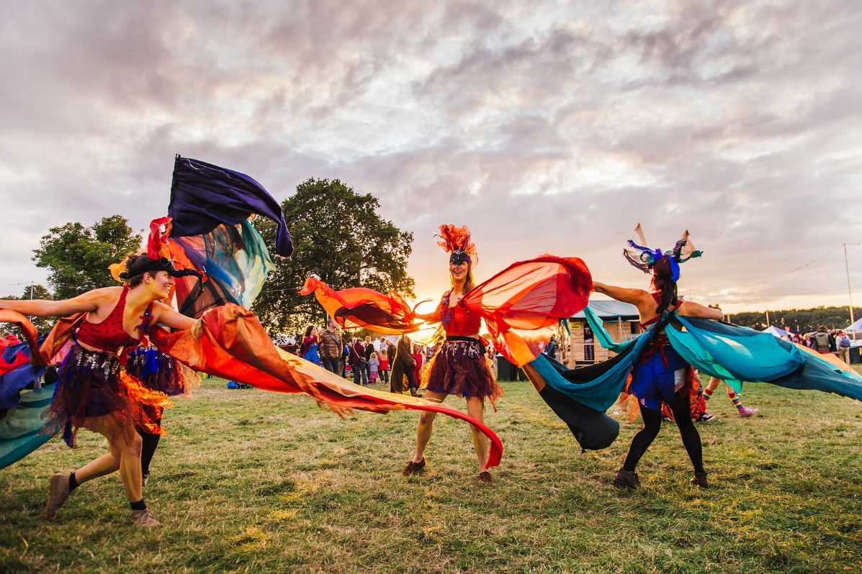
Art must be as interesting as reality
… is hard at a festival !
Must communicate instantly,
and primally…
Shambala Festival
Shambalafestival.org

Slide 8
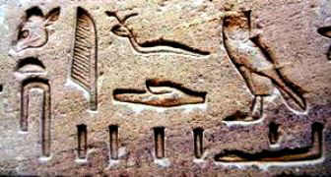
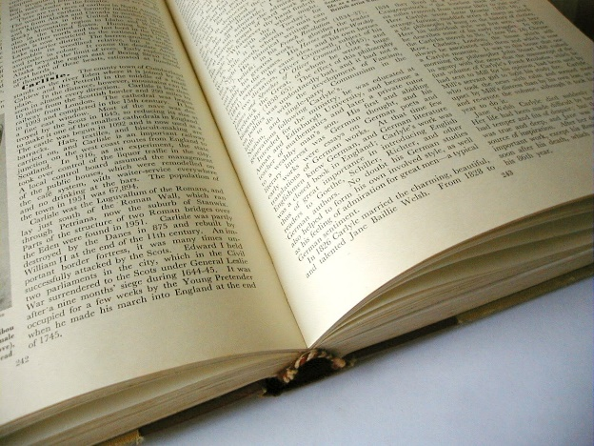
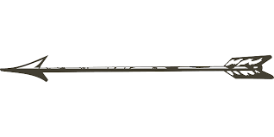
Communicate instantly on a primal level
Heiroglyphs
Recent history’s default
Today
3,000 BC
Words
Elitist
(must be learnt) and lack emotion
emoticons
https://tainn.wordpress.com/

Slide 9
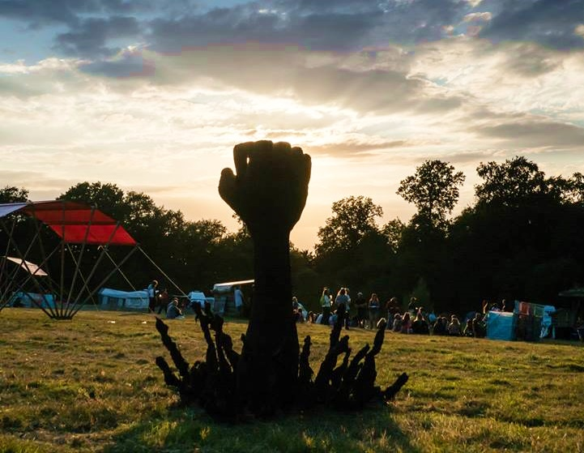
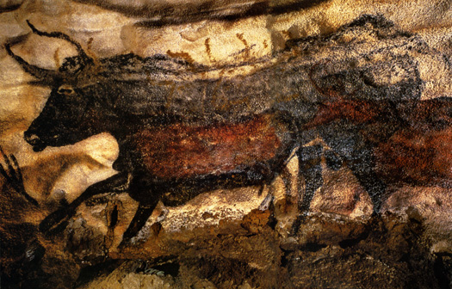
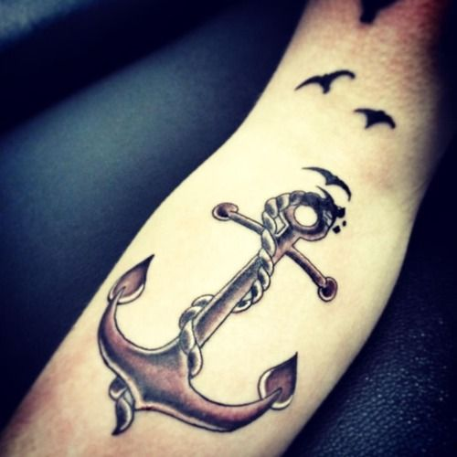
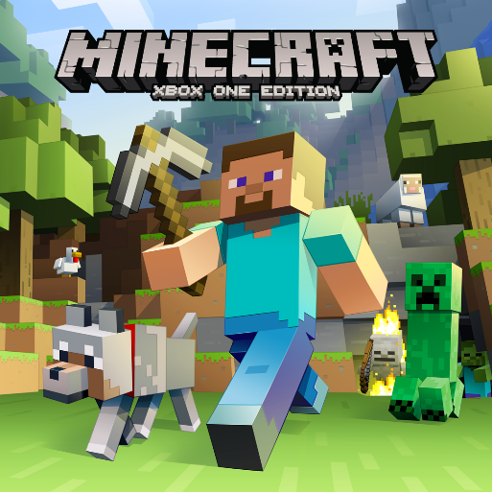
Heiroglyphs
emoticons
Words
Cave Art :
The origins of
Labour and leisure, collective pleasure, expression and rebellion
Lascaux
Internet Global connectivity: People remove language barriers and form tribes
selfandsocietyfall2013
Potency of Symbolism:
memories and desires
gettattooideas.net

Slide 10
Chat break ?

Slide 11
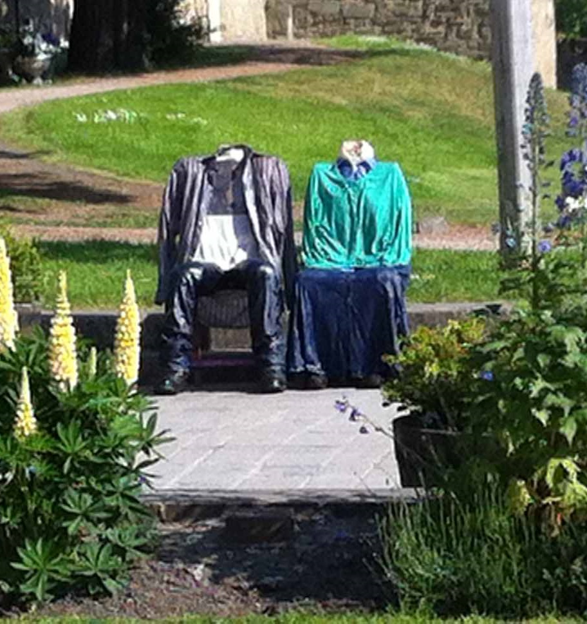
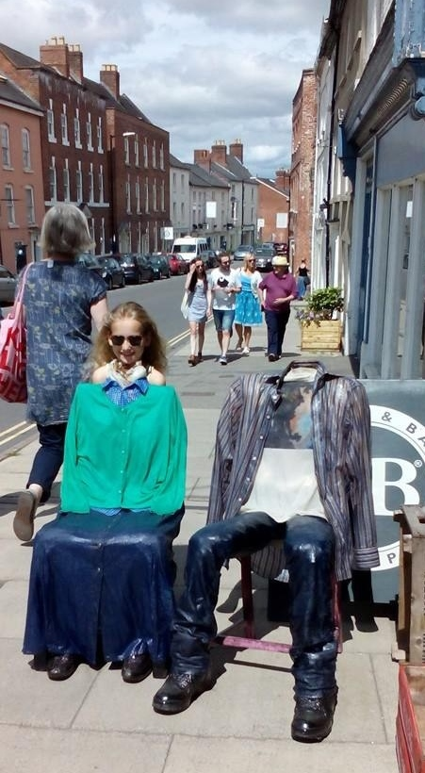
What do these mean to you (and what are they like to sit on)?

Slide 12
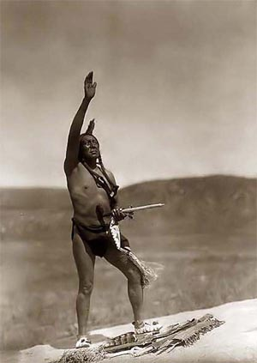
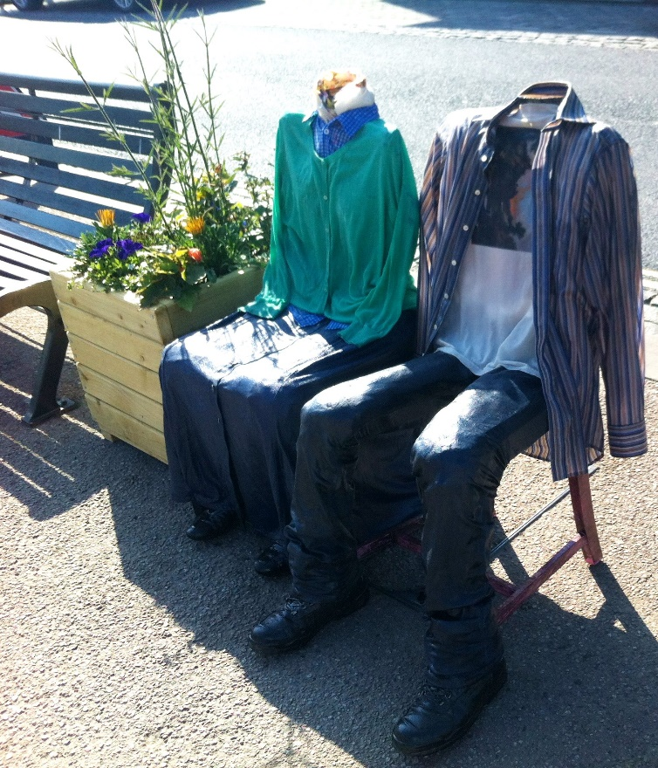
Cherokee Chairs
The land is ours, The land is us
Land rights in the
colonisation of America
The Indian Allotment Act (“the Dawes Act”):
the assimilation of native North American Indians.
Chief Standing Bear, a Ponca Indian of the Lakotas, and his tribe, walked 600 miles though winter to bury his son after being forcibly removed from their native territory and burial site.
Tribal land was removed from tribal governance and allocated into immediate family ownerships, and to single males – small allotments, effectively removing collectivised responsibility and collective management of the land and nature.
Image: Indian prayer sonofthesouth.net

Slide 13
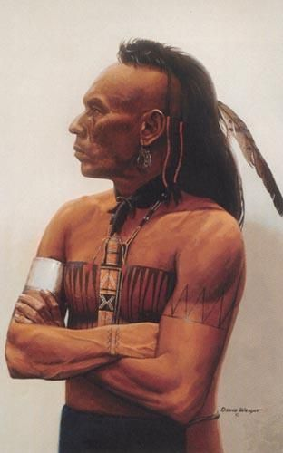
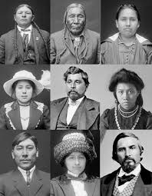
Chief Standing Bear’s contention to rights to bury his son in the tribe’s sacred ground was “I am a man”.
This human claim was assessed through long court trials.
It was eventually accepted because he wore western
Westernised native North Americans
clothes, adopted western doctrines, and asked to be taught how to farm land the western way.

Slide 14
After the Indian Allotment Act was effected Standing Bear could have been renamed ‘Sitting Clothed’: a westernised sitting tenant in the required Euro-American attire. The chairs are dressed in keeping with the spirit of those traditional clothing customs of the time.
We can sit on these Cherokee Chairs in recognition of this heritage’s fundamental support for our current condition.
The sealing of the chair people reflects the sealing of free people into a restrictive and immobilising law and way of life.
The Cherokee are a native North American tribe.
“Cherokee” means “the real people”.

Slide 15
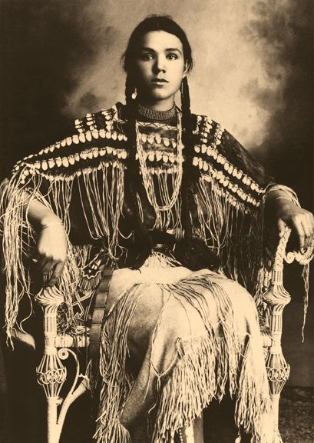
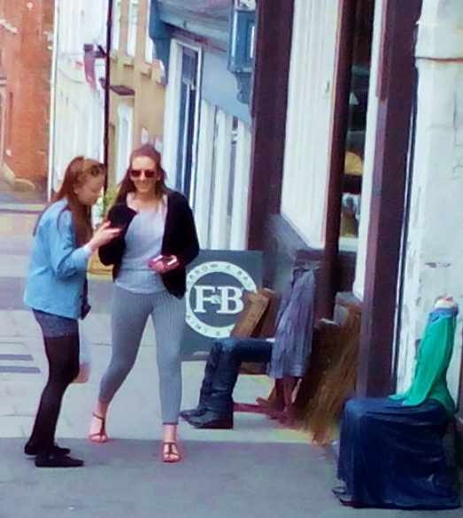
Other tribe names… what do they mean?
Lakota
Sioux
Kiowa Indian Portrait by Edward Curtis: Kokopelli via Lynne Buckson from Native American: historical photos

Slide 16
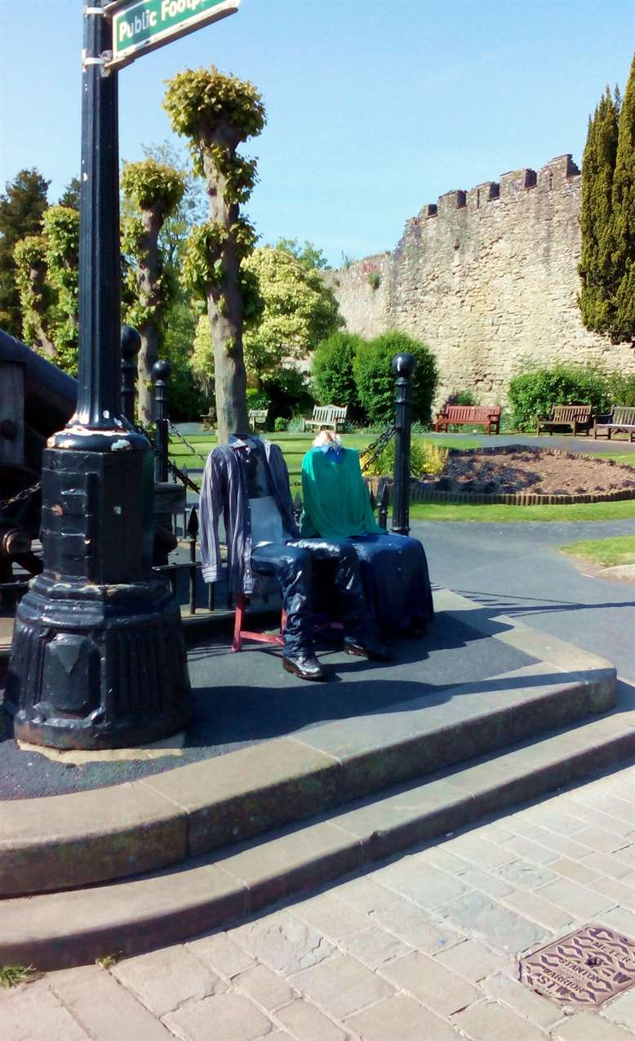
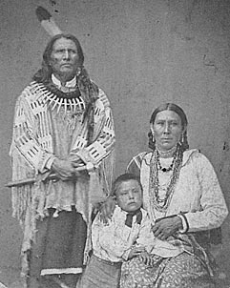
“We did not think of the great open plains, the beautiful rolling hills, and winding streams with tangled growth, as “wild.”
Only to the white man was nature a “wilderness” and only to him was the land “infested” with “wild” animals and “savage” people. To us it was tame.
Earth was bountiful and we were surrounded with blessings”
Standing Bear and his family, 1903, several years after the trial. Courtesy Nebraska State Historical Society
Cherokee Chairs
the real people

Slide 17
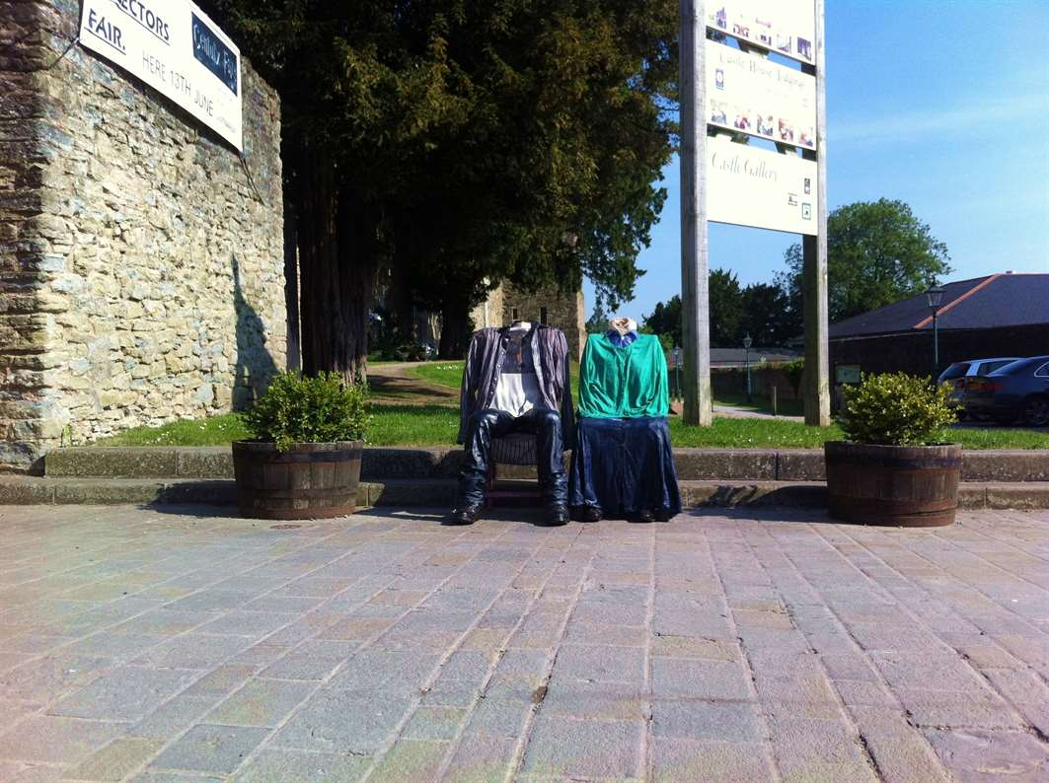
Legacy
Standing Bear Lake park: 396 acres
(Ponca Tribe had lived in 50,000 acres.)
“Standing Bear Lake park sits in the middle of
various housing developments.
This makes it
easy to get to,
yet it still offers
a secluded area to relax
and
get away from the city.”
Lessons from History….

Slide 18
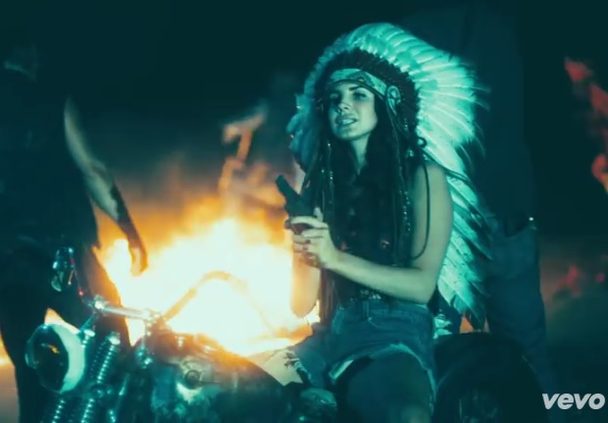
2) Tribal Chiefs rule!
(because they don’t rule)
1) Headdresses are awesome!
Lana del Rey – Ride (full length)

Slide 19
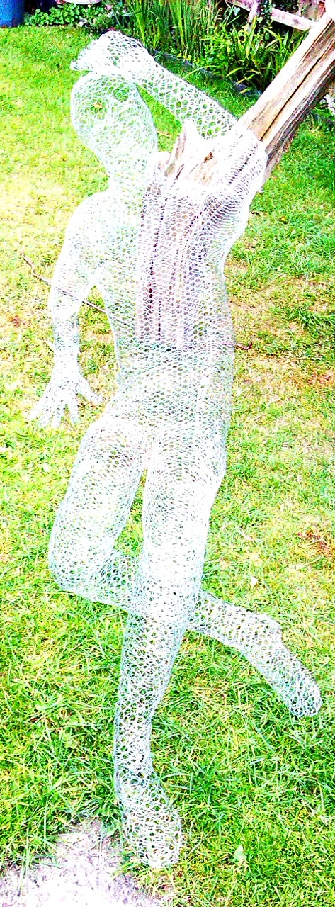
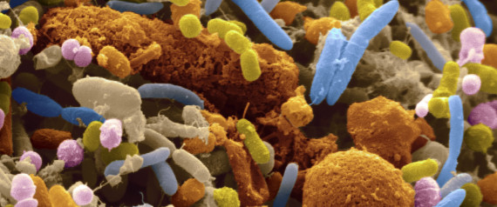
Who are “the real people”?
Bacteria (gut)
About 10% of our cells are human. 90% are bacteria. In terms of number of cells, a person is mostly bacteria. Bacterial cells are much smaller. They amount to about 2% of our body mass. So about 1½ litres of each of “us” is bacteria.
Mostly good bacteria!
A person is a collective.

Slide 20
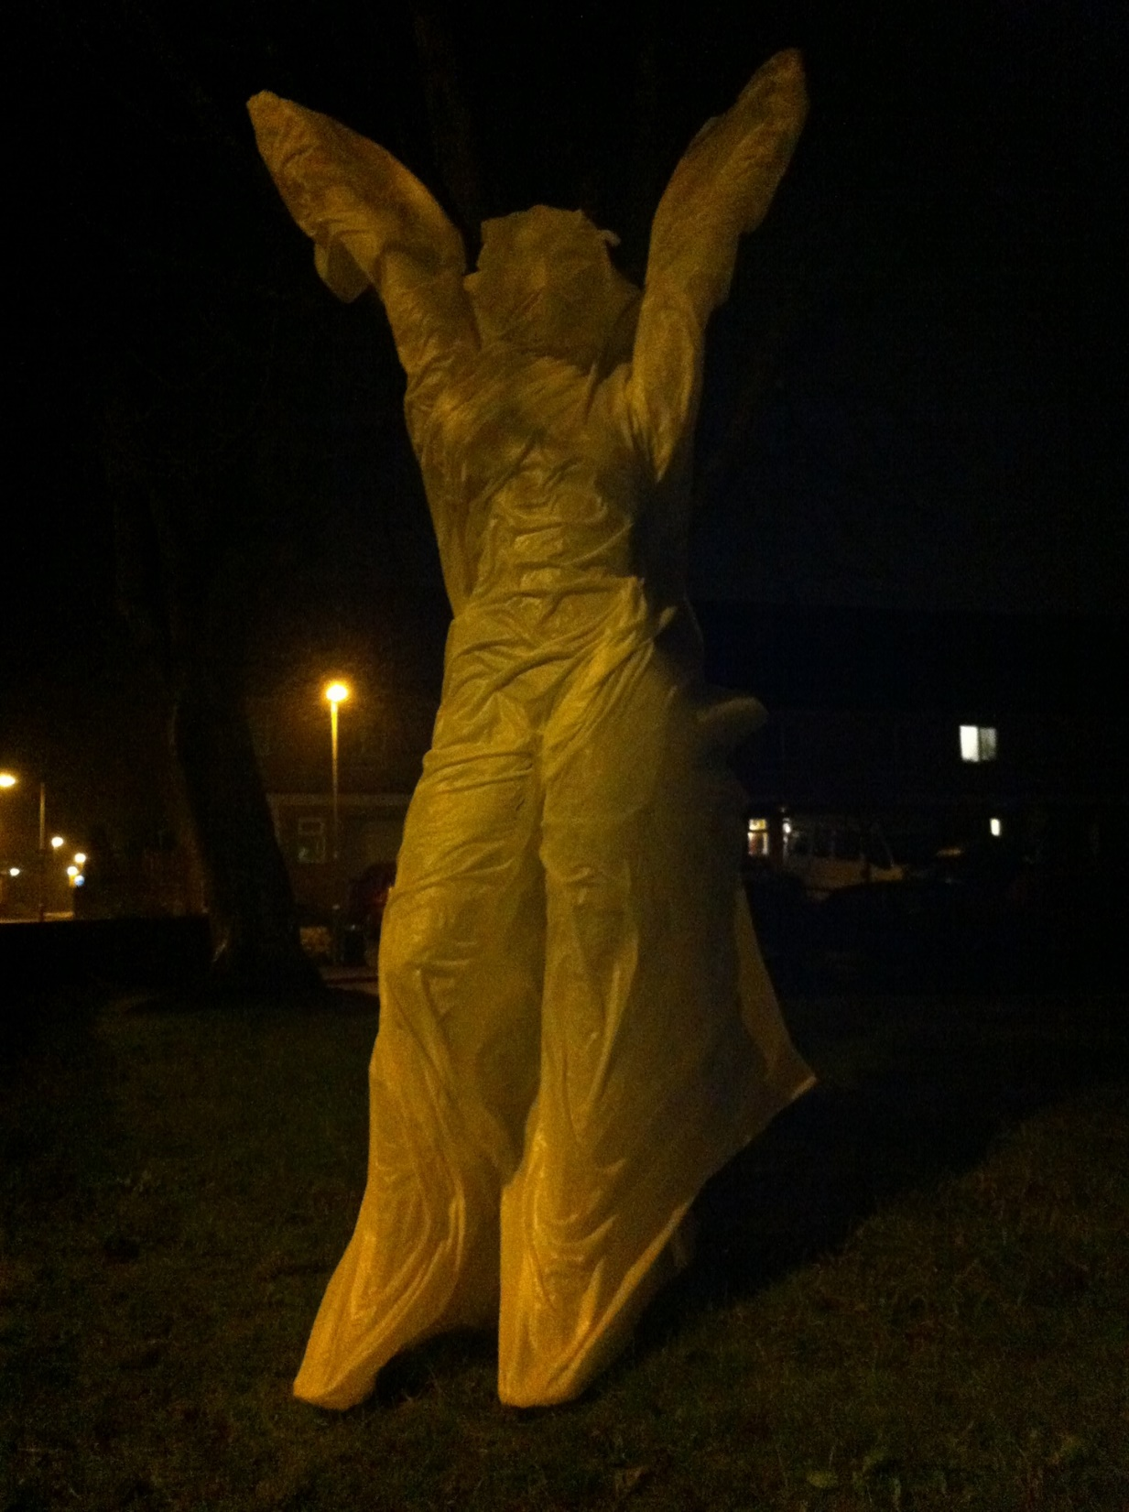
Are ghosts people
?

Slide 21
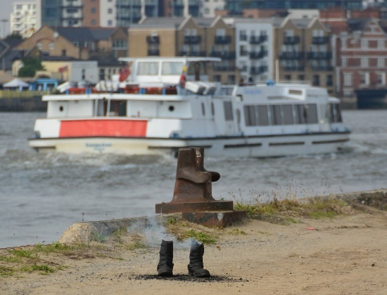
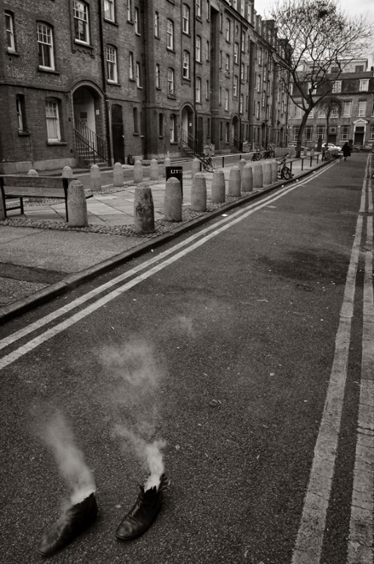
Hackney and Greenwich
Images courtesy of The Plague Doctor

Slide 22
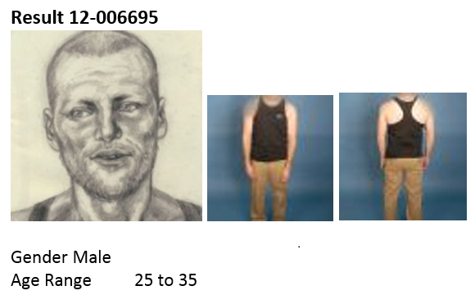
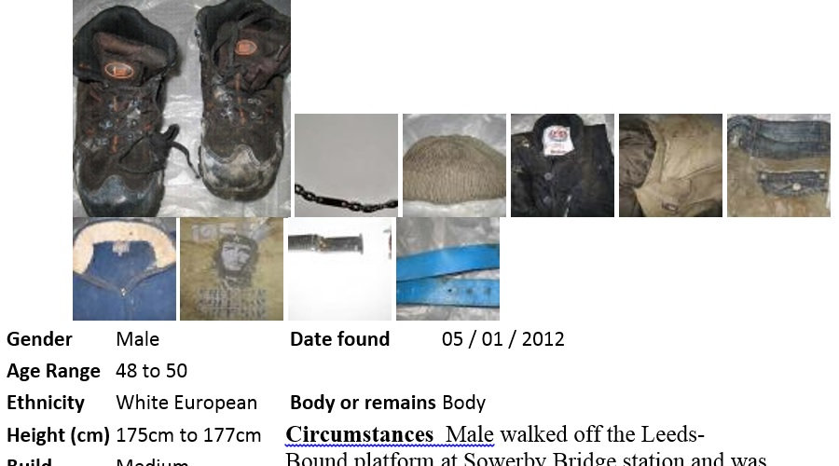
missingpeople.org.uk

Slide 23
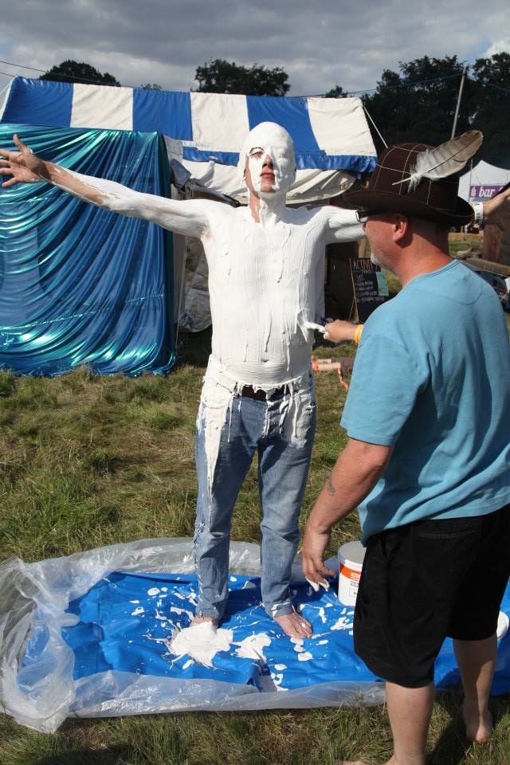
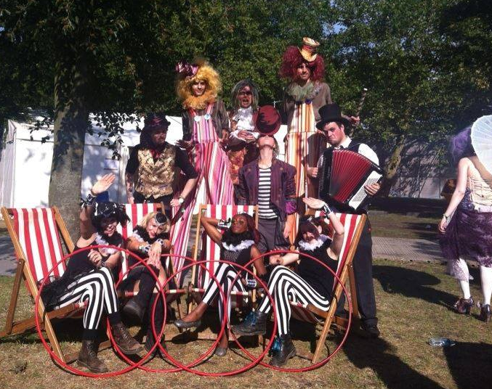
Some missing people
join the circus
Images: JamieDodgerland, Jemima Broadbridge
re birth
Chivaree Circus

