Slide 1
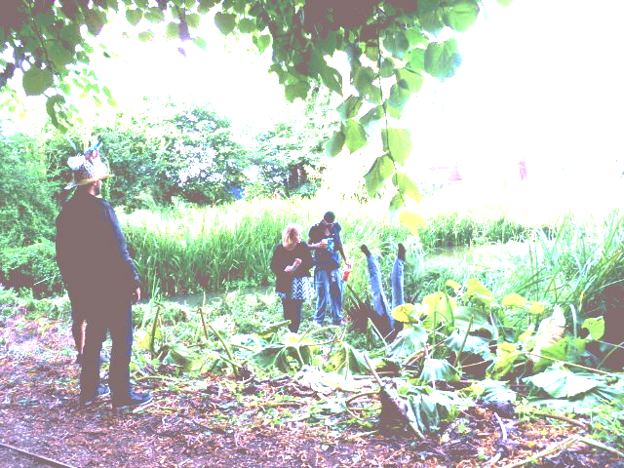
Land based sculpture through cave and street Life in Earth MattSmart.org matt.smart@mail.com 07500118791 Image: Shambala Festival

Slide 2
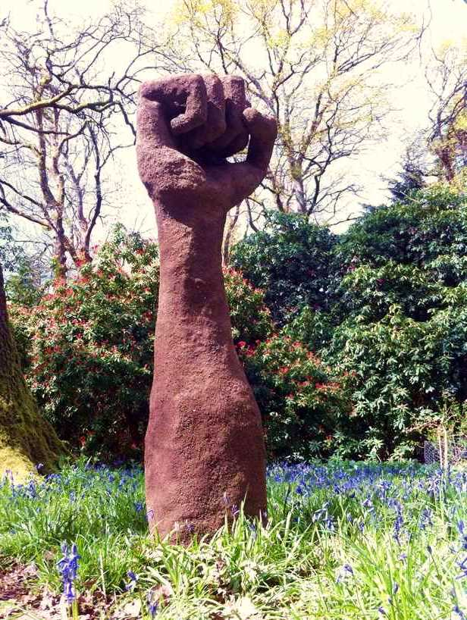
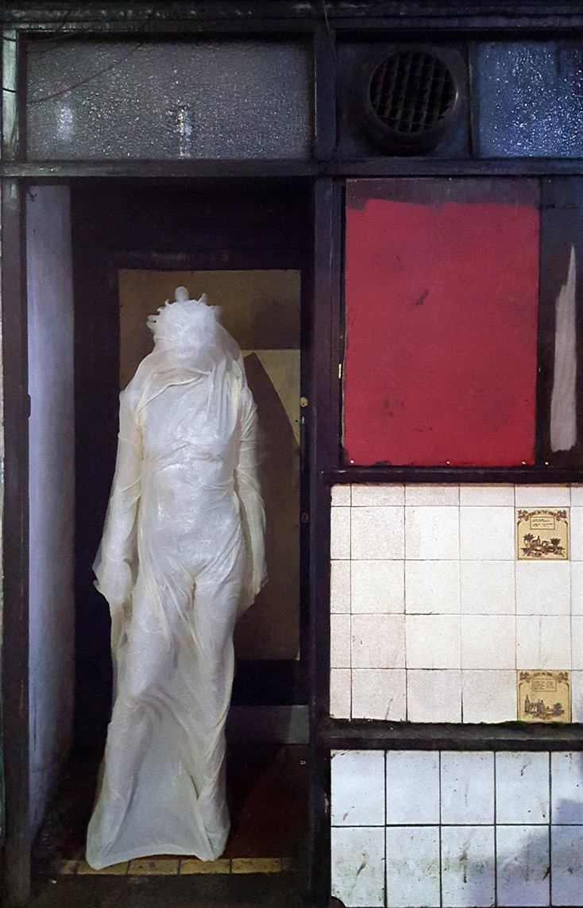
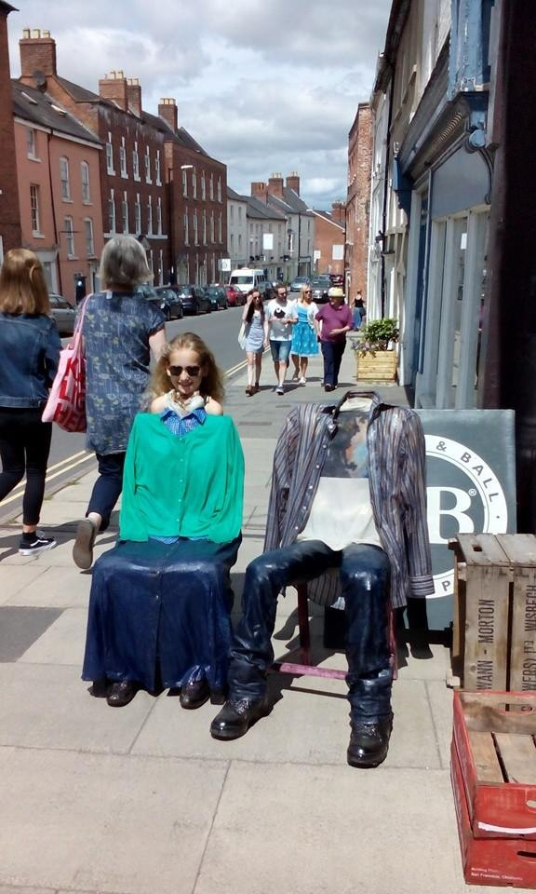
What are they about ?

Slide 3
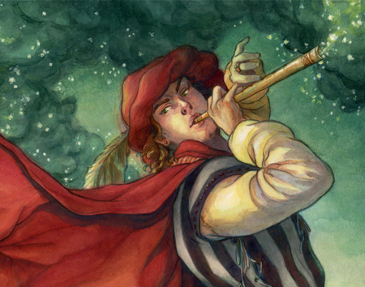
Make Magic Not Art
The Pied Piper by Elisabeth Alba
http://steelthistles.blogspot.co.uk/2012/04/pied-piper-of-hamelin.html

Slide 4
We live in thought space

Slide 5
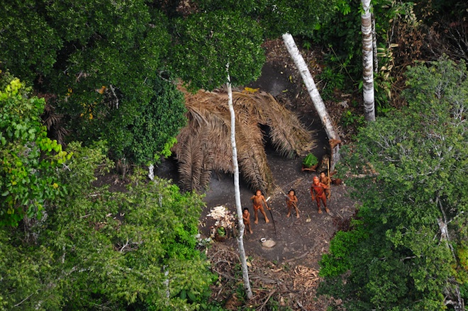
Predominantly natural surroundings…
Uncontacted tribe in Western Brazil, possibly Panoan
Image courtesy of Brandon Keim, freelance journalist, and Wired, 2011 http://www.wired.com/2011/02/uncontacted-tribe/

Slide 6
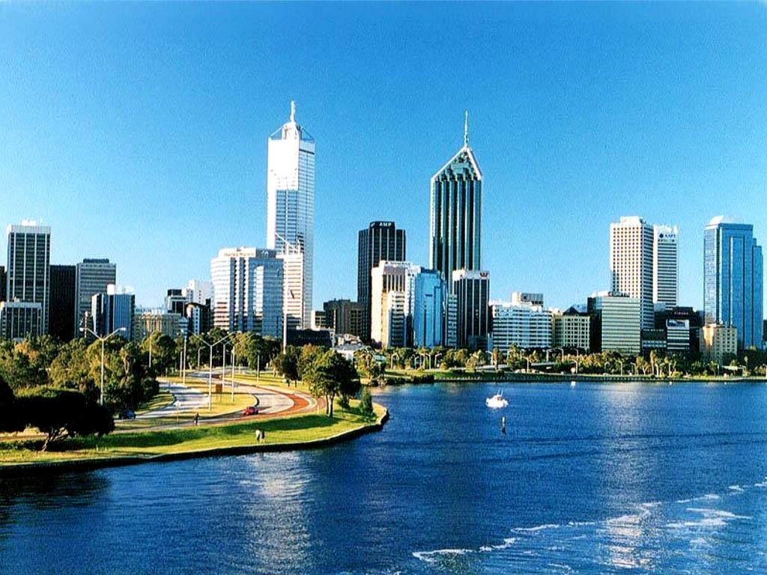
Results of thought… (except for the water and the sky)
Perth, Australia
Image courtesy GloHoliday http://www.gloholiday.com/famous-places-in-perth-australia/

Slide 7
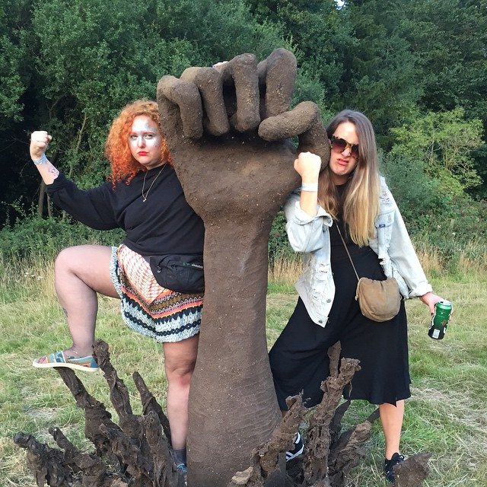
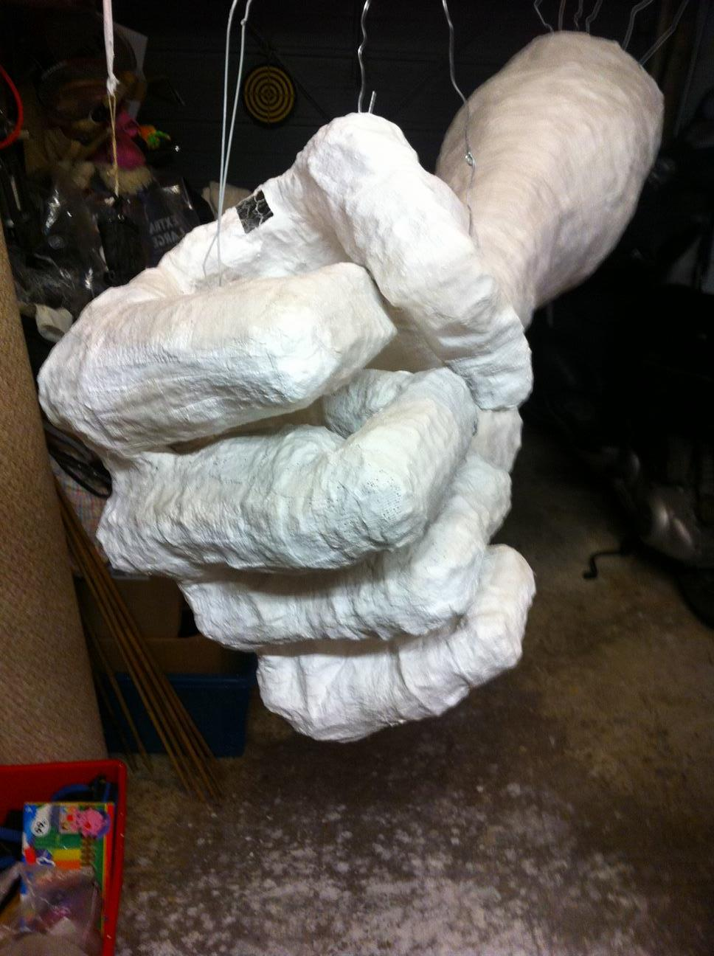
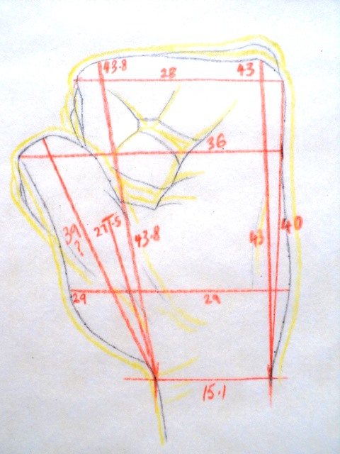
Artist as Magician

Slide 8
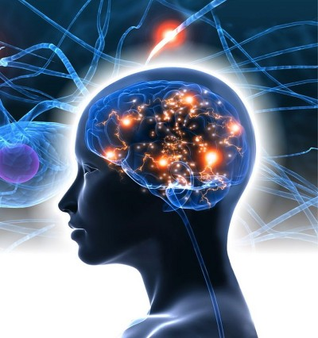
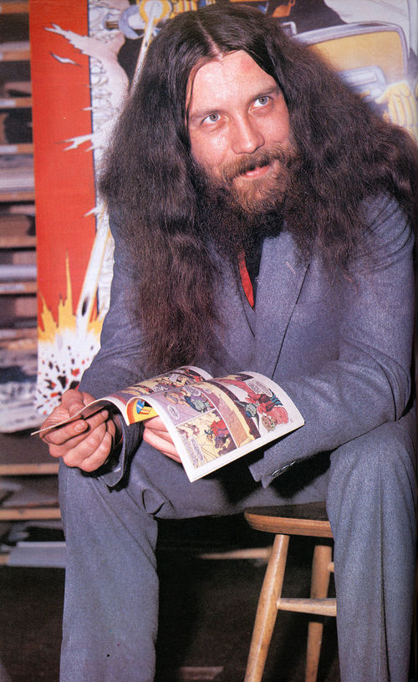
The meaning of “Magic”
Alan Moore
http://starwars.wikia.com/wiki/Alan_Moore

Slide 9
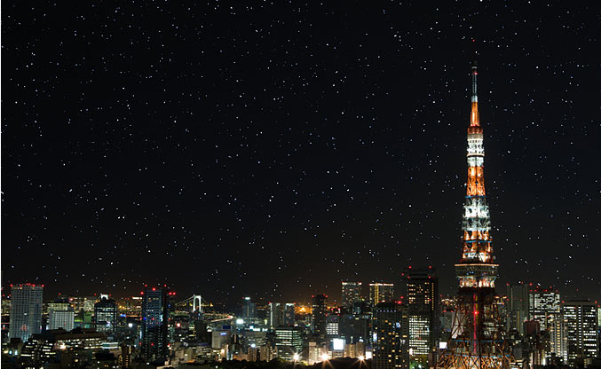
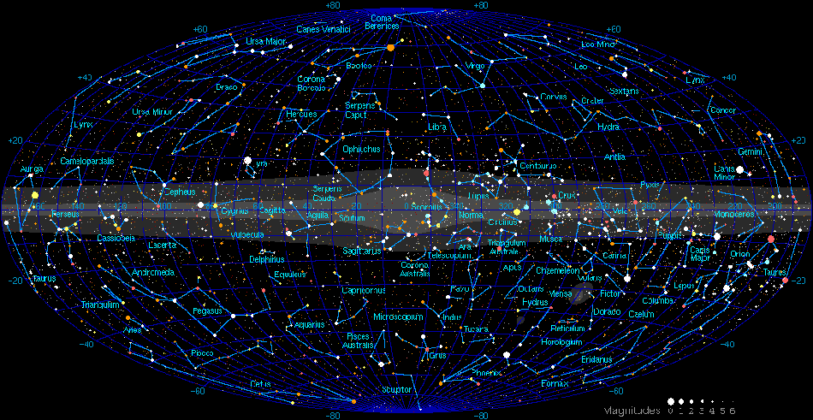
What makes the grass green?
Actors
Marilyn Monroe
Julia Roberts
Pretty Woman Erin Brokovich
“Actresses”
Scarlet Johanssen
Lost in Translation Superhero movies
Karaoke scene
Bill Murray
Wu Tang Clan
go-astronomy.com

Slide 10
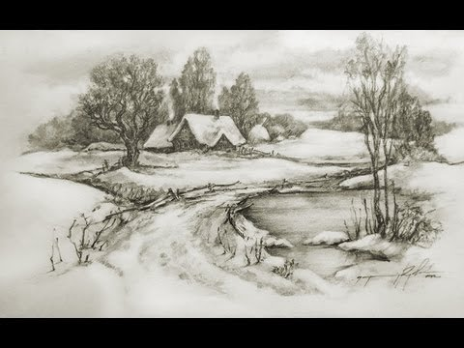
“Speed Drawing Pencil, Landscape | Cool Drawings - Tanked Studio” - Youtube
https://www.youtube.com/watch?v=OGqPf2UEqKQ

Slide 11
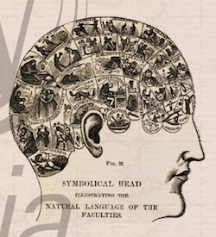
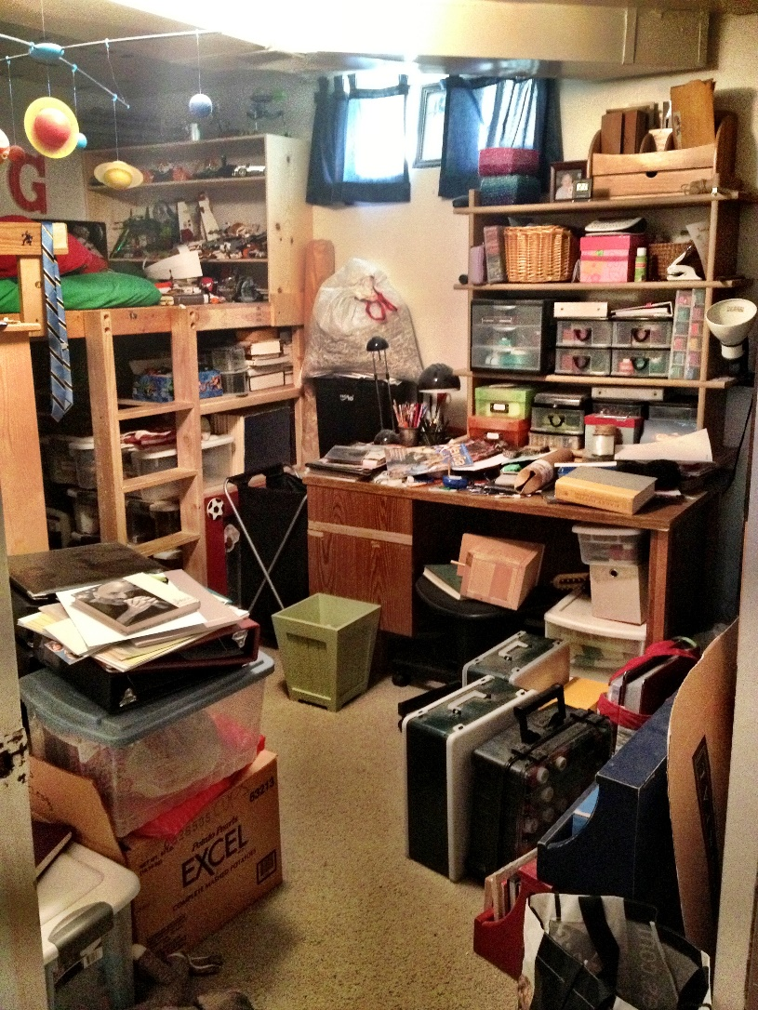
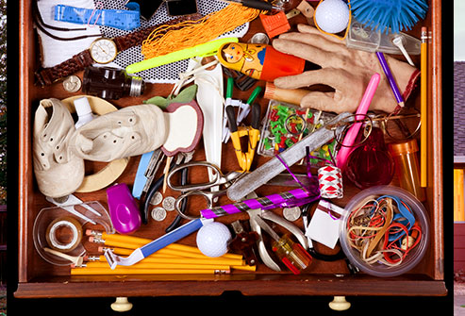

Slide 12
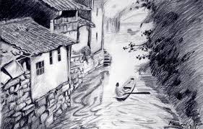
Adventure to find ideas, to find new lands
“Where do you get your ideas?”
They’re out there. We go find them.
http://bijigan.tk/landscape-drawings-2/

Slide 13
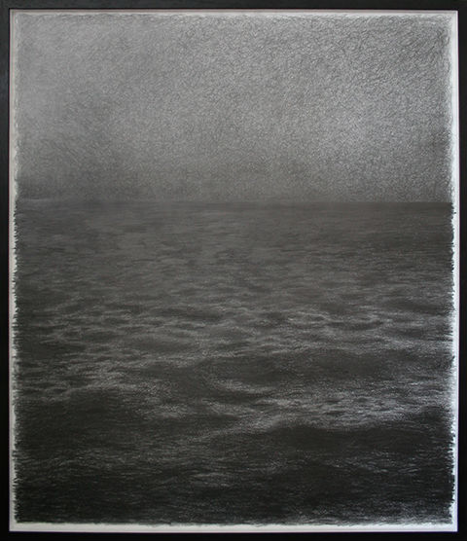
Lets Just See What Happens by Emma Coop, 2015, Graphite on paper emmacoop.co.uk

Slide 14
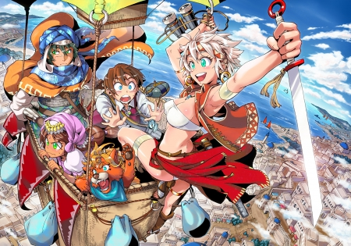
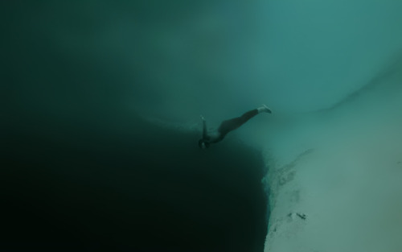
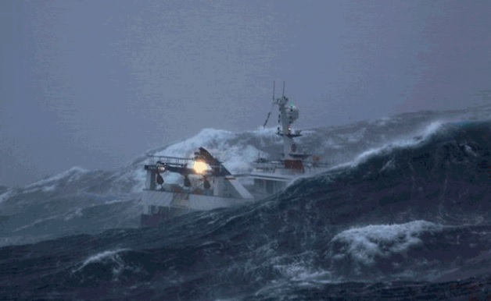
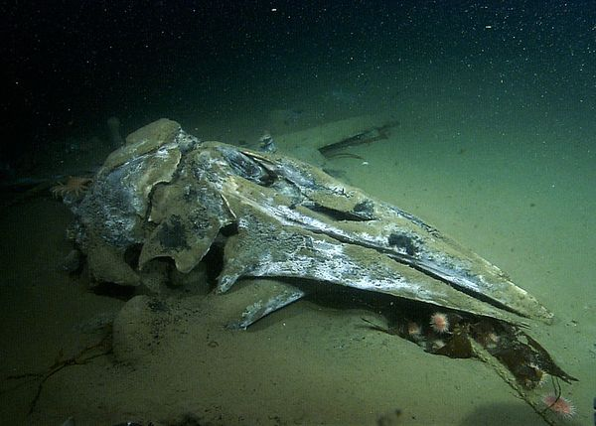
Artists
navigate perilous
oceans
http://sixpenceee.com/post/129616022244/confession-of-a-deep-sea-diver-by-reddit
Fishing boat, North Sea
Whale carcass
http://www.mackerelfishinglymeregis.com/news/have-you-ever-been-on-a-harvester-227
http://www.foxnews.com/story/0,2933,575406,00.html

Slide 15
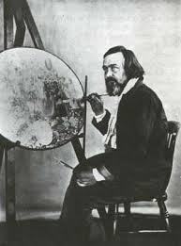
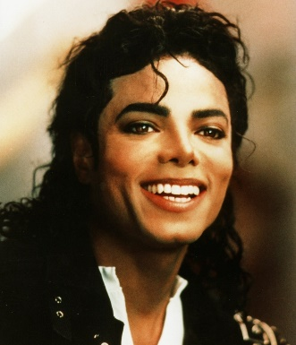
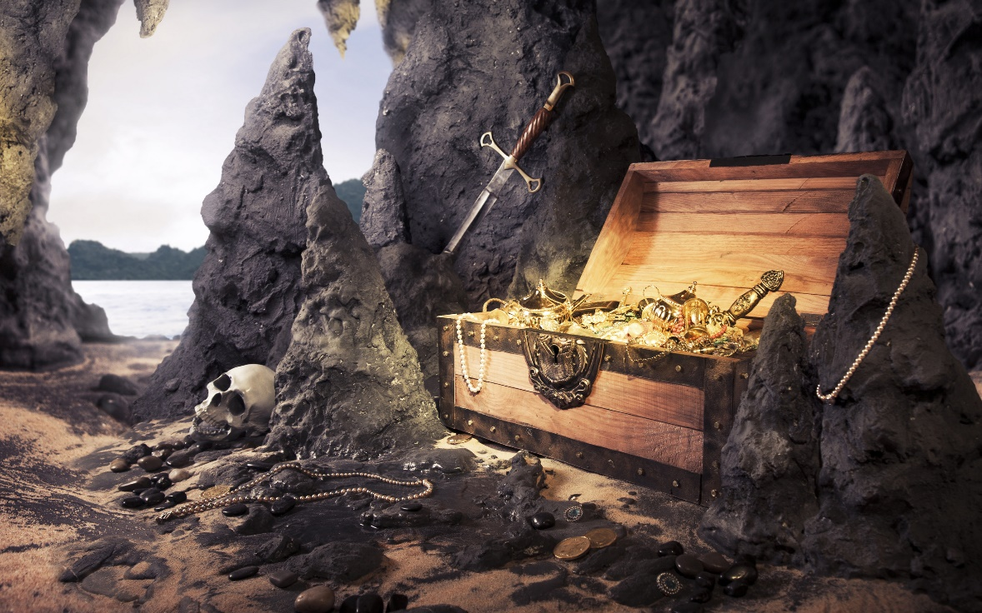
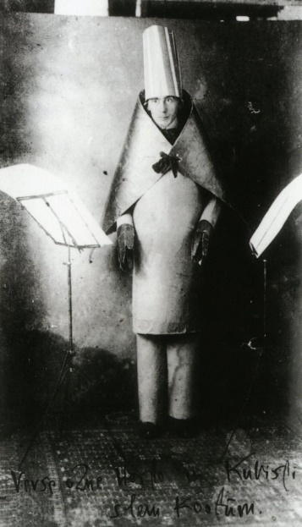
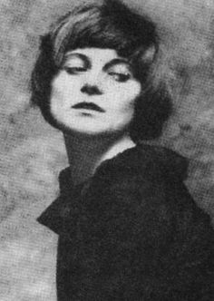
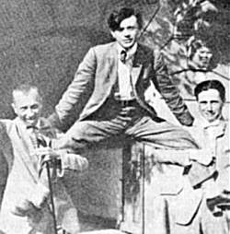
Richard Dadd
Explorers on the edge,
and
found Treasures
KatieJane Garside (Lyrics, music and voice in Daisy Chainsaw and Queen Adreena)
Dada: Hugo Ball, Tristan Tzara, & Emmy Hennings

Slide 16
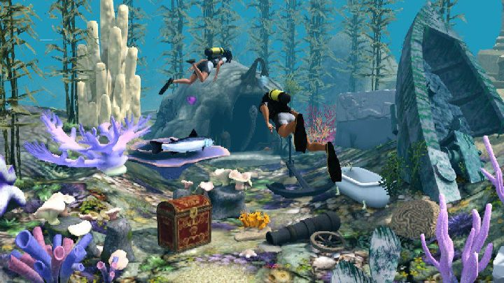

Slide 17
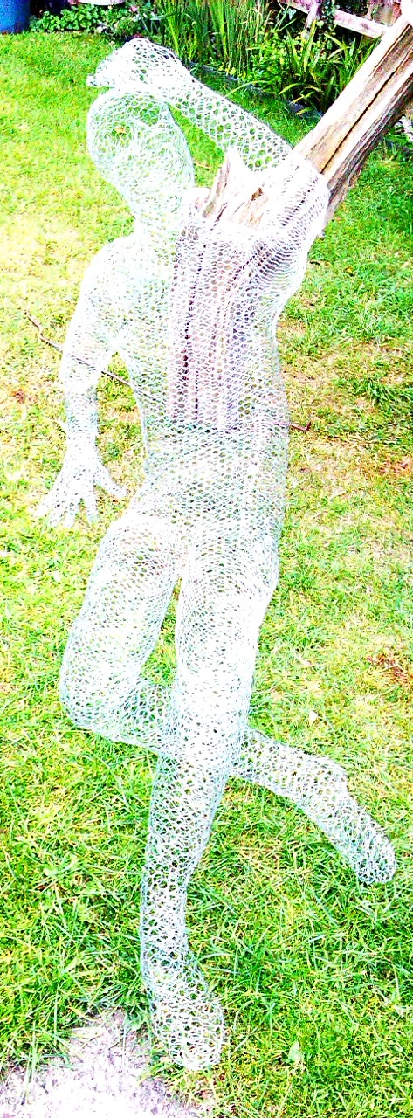
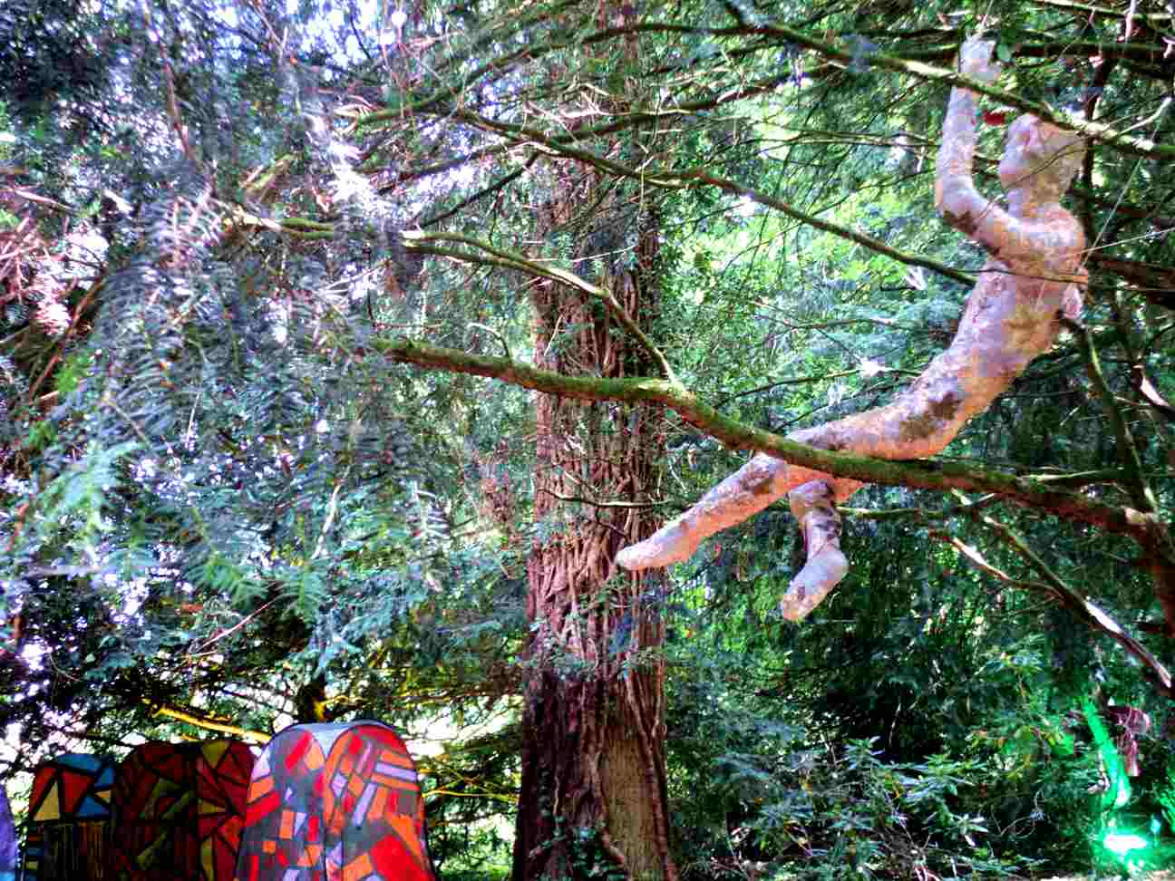
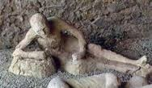
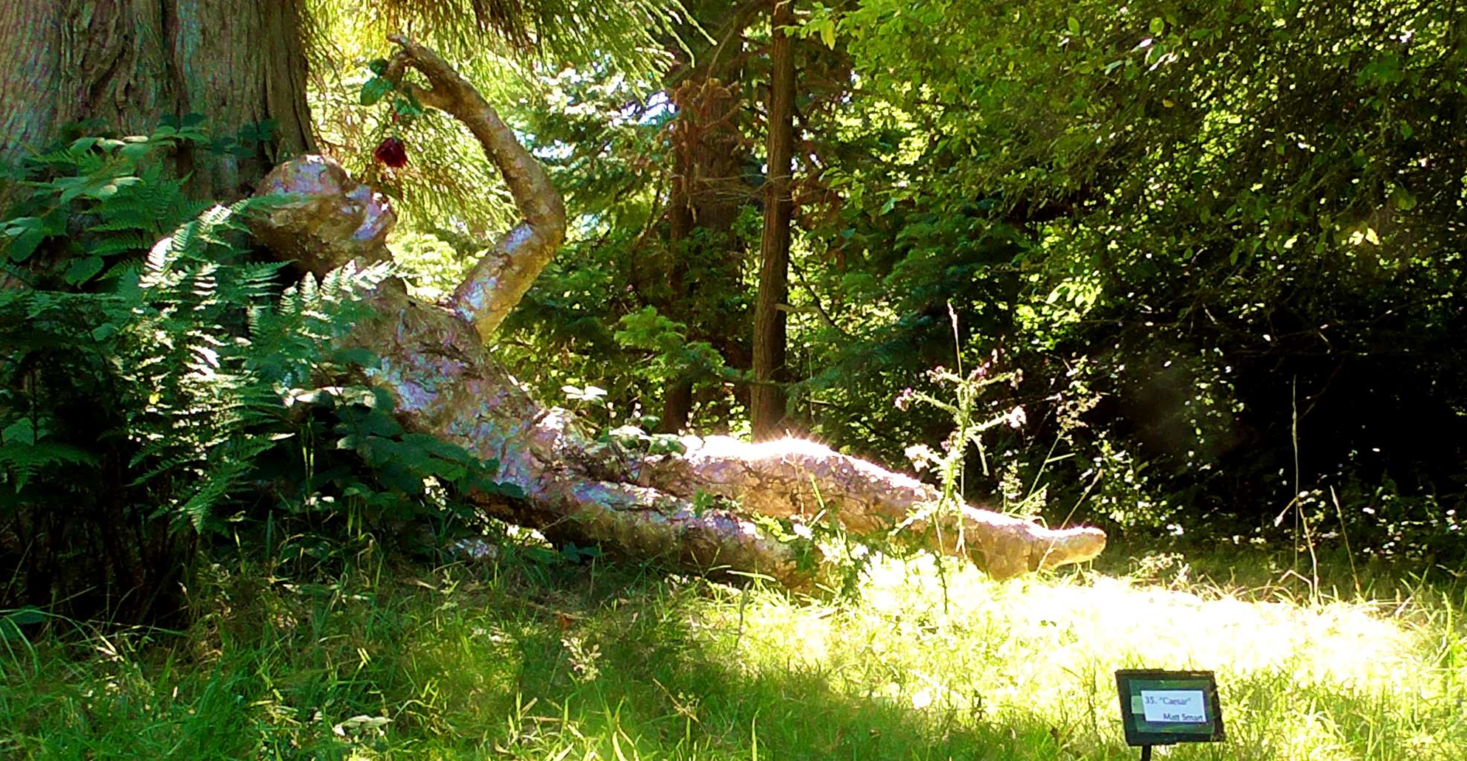
Seizar

Slide 18
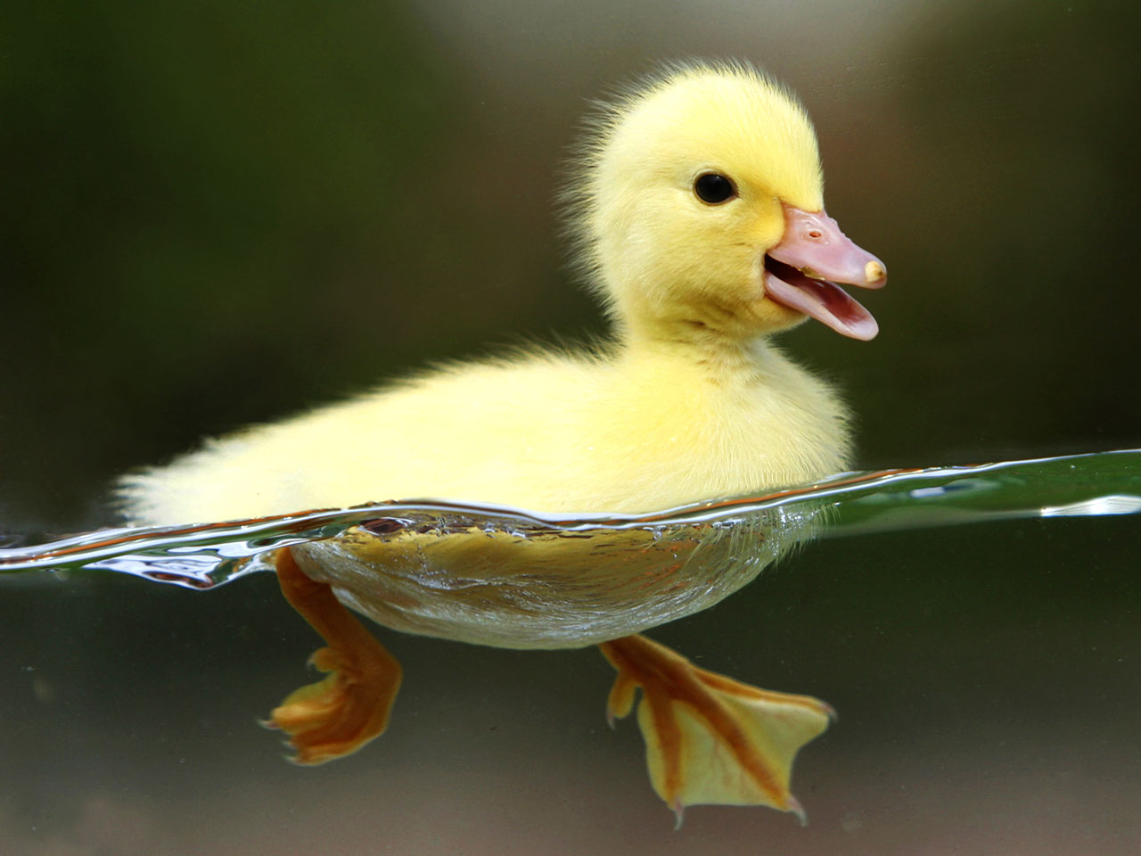
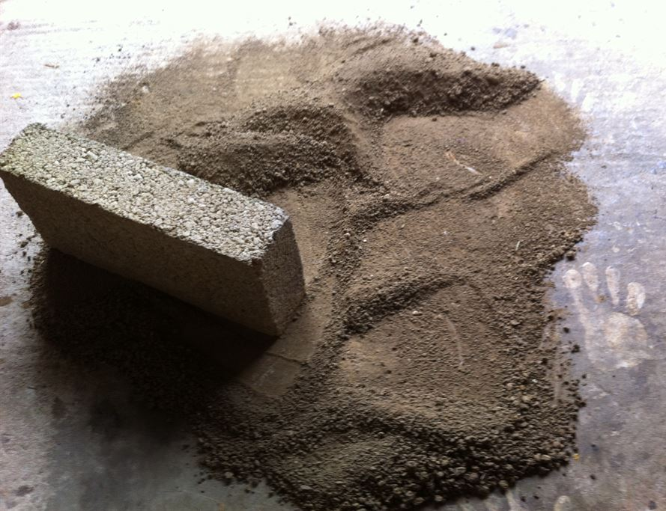
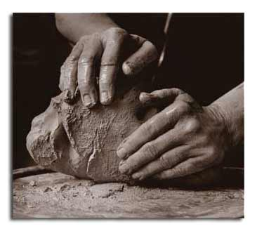
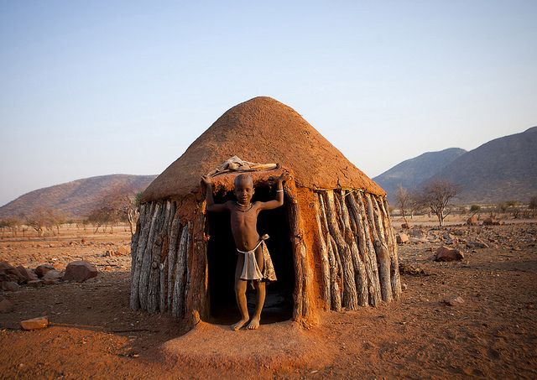
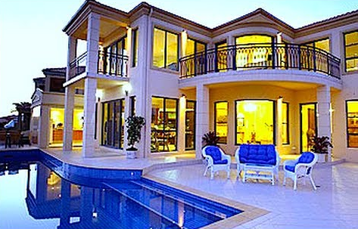
We live in mud
curiositysip.com
Himba Boy In The Entrance Of His Hut, Okapale, Namibia Eric Lafforgue

Slide 19
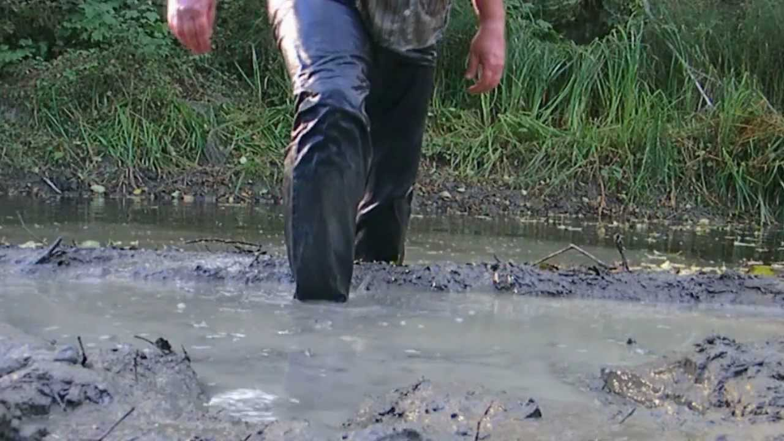
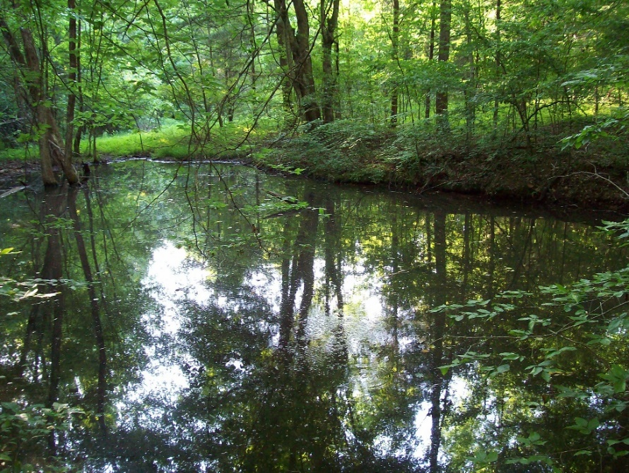
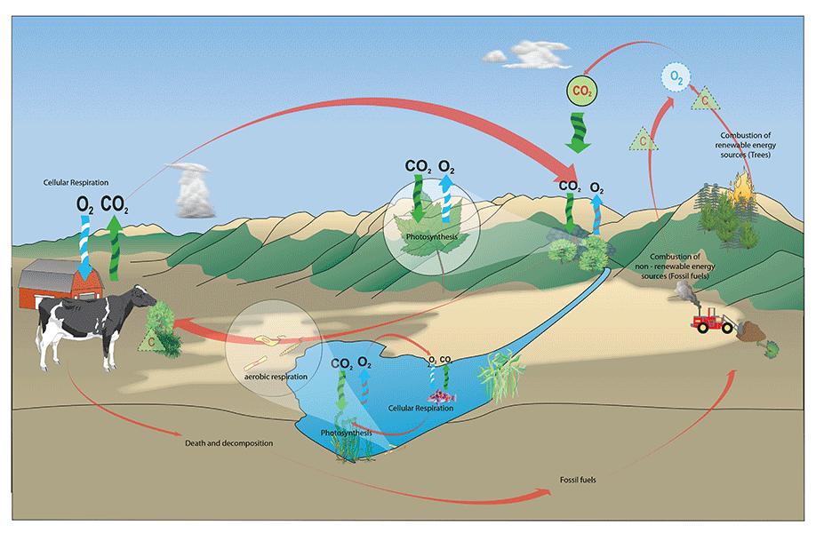
youtube.com/watch?v=otaC46q6S_4
ZoMbIe_xD on chickensmoothie.com
We are
of mud
…skies, grey clouds, dark and birdless above barren fields; hard roads and wet paths: puddles, reflecting in the earth the sky's despair; fallen trees rotting at the feet of their fellows, unseen barking dogs and a thin orchard with a crow, half stripped by wind and rain, hanging by its neck from a skeletal tree, to ward off other thieves and scavengers.
I wanted this forsaken place to devour what I had started, and at the same time to help me grow into some other form. Among this dark and smothering fertility I would start anew.
…It was among these ruins that I hoped to find sanctuary, to scrabble with bared claws into dead leaves and damp earth and bury myself in the woods, head first, leaving a leg sticking upright from the soil like an indignant sapling.
news.bbc.co.uk

Slide 20
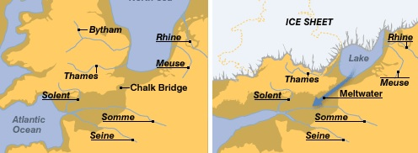
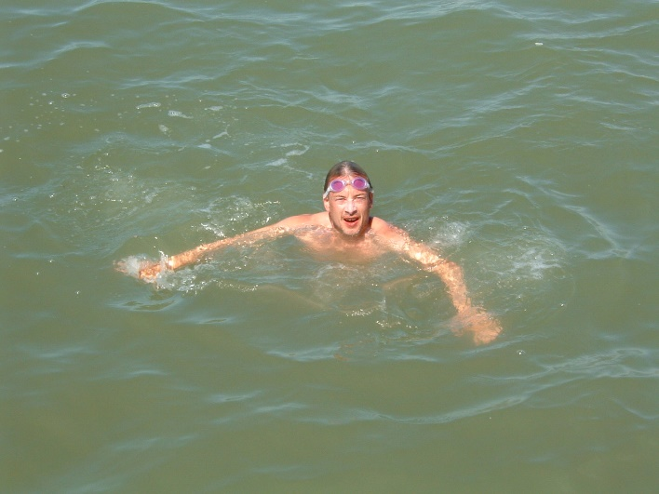
Mud connects thought islands
It’s Alive!
We are Mud
I am Mud
Touched the bottom of the Channel
news.bbc.co.uk

Slide 21
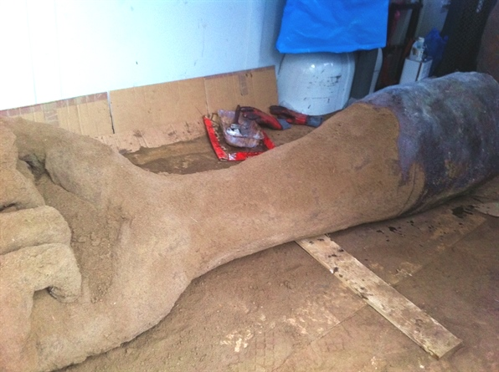
Why work in Earth ?

Slide 22
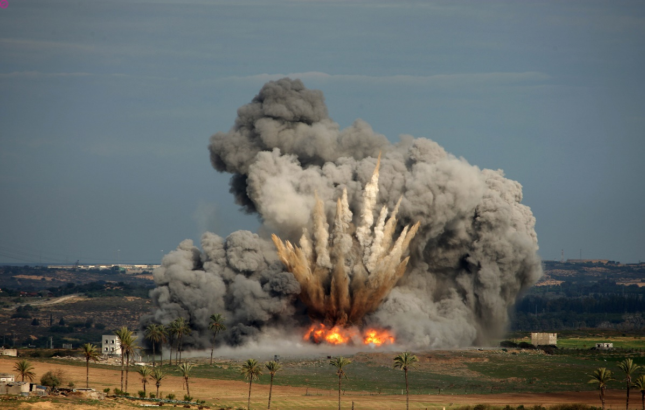
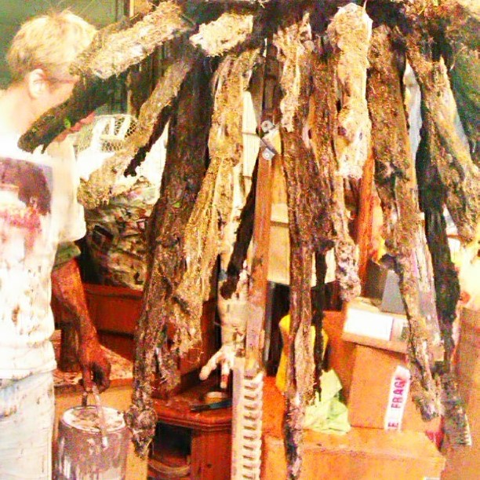
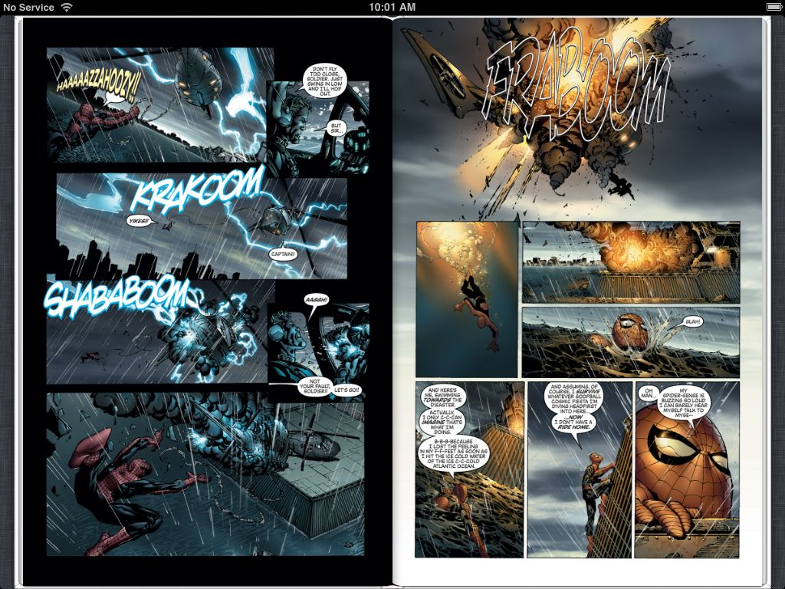
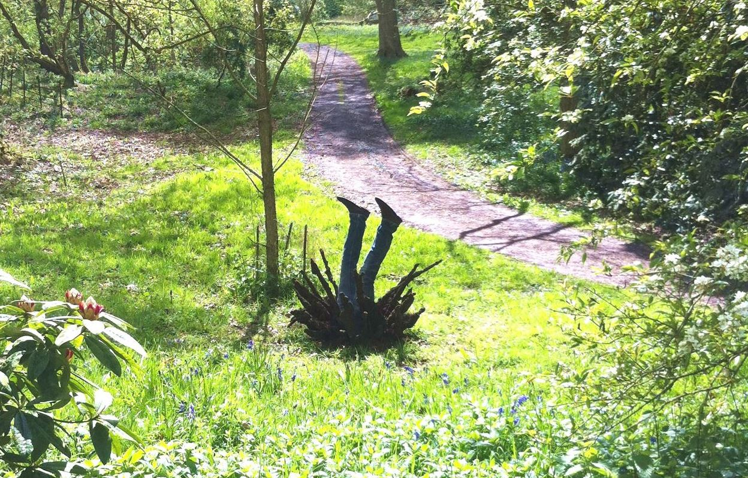
Make
an
Explosion
Make
a
Splash
Marvel comics

Slide 23
taringa.net
RichardLong.org
The Gormley
Anthonygormley.com
Land Art, Earth Art
(make it accessible
and relevant)
Faces
avoid them
(skill and specificity)
Turkesa, street artist & Tattooist
andrewfowlerphotography.blogspot.com
Sark, Grand Greve, Channel Islands

Slide 24
Earth as a document
Digging, touching…
The feel of earth on your skin
Truth, set in layers
‘The New Dawn’ by G.C. Myers
http://redtreetimes.com/2011/11/30/archaeology-rainbows-end/
Me and Stuart, archaeological dig in Russia

Slide 25
Archaeology: Fact vs Truth
Russian Romanov Imperial family:
Tsar Nicholas II and family, including Princess Anastasia and Alexei (haemophiliac) heir to the throne
Executed 17 July 1918. Found 1991 (1979) and 2007 (2004)
Alexander Avdonin and Gregoriy Zaitzev with Michael Buchanan-Smart at the gravesite, 2004
Alexander Avdonin examines team’s findings, 2007

Slide 26
← The secret site, June 2007
2005, top part of Fibula
The more beautiful Truth …
Alexander Avdonin on site, 2007

