Slide 1
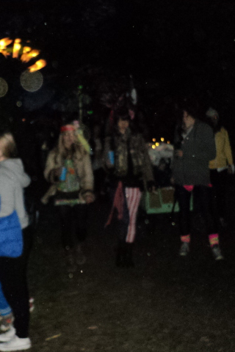
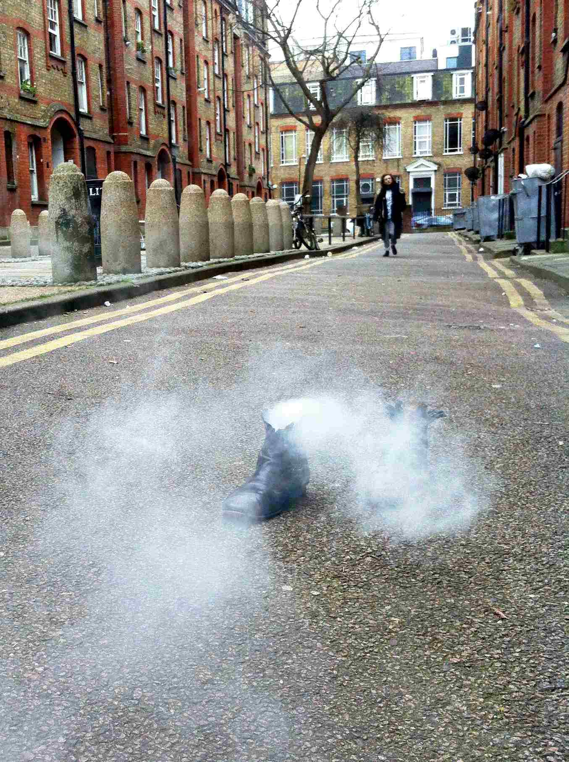
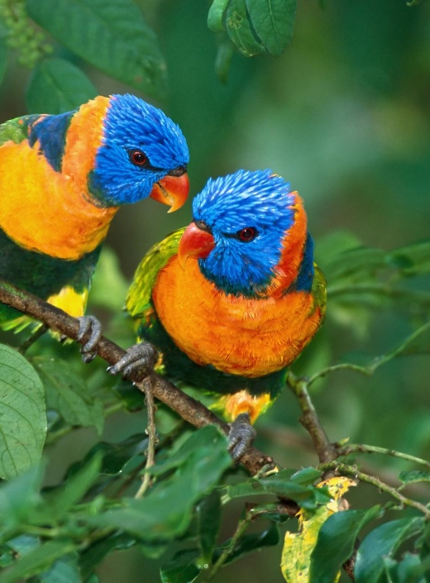
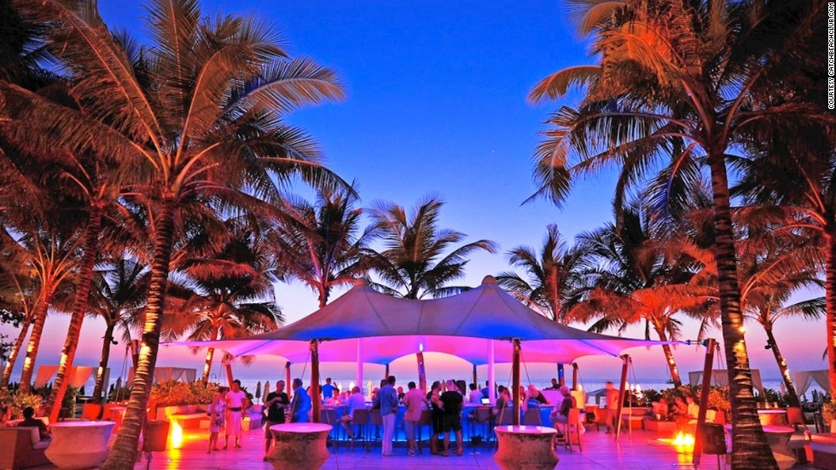
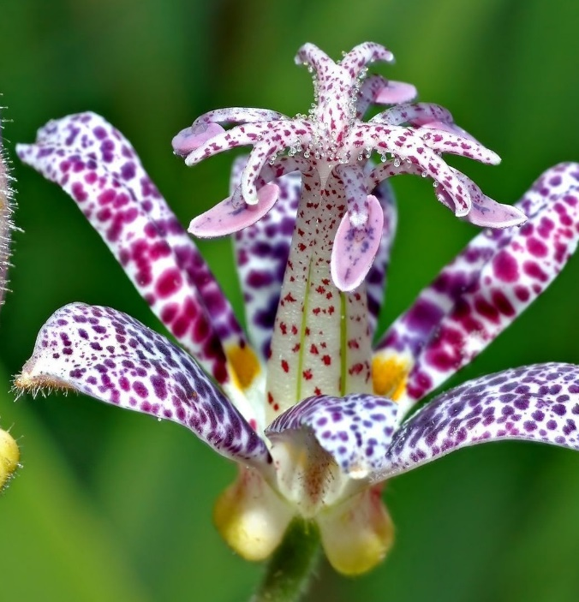
Desire to run off and
join the circus
Why do people do anything?
Desire.
…. for…. fun,
excitement, pleasure,
A fortunate point in art appreciation….

Slide 2
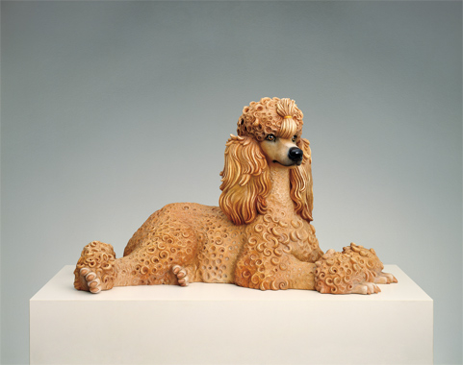
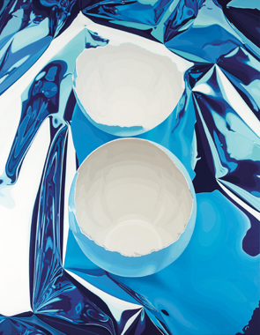
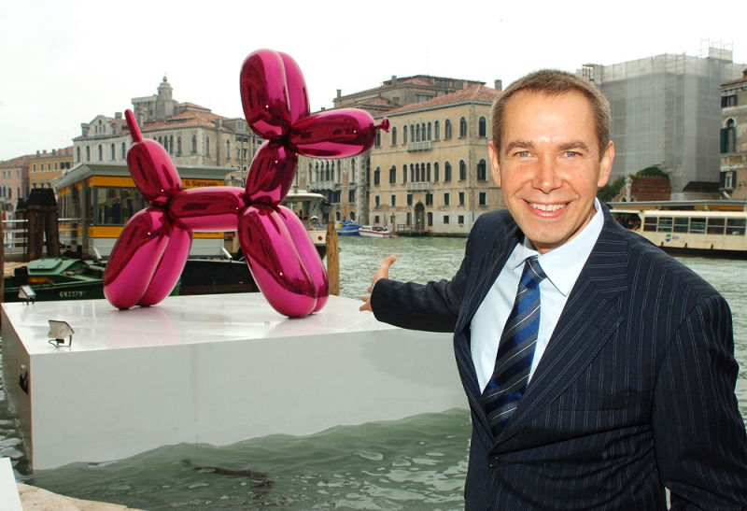
Jeff Koons
“It might not be their desire in life to reach the
bourgeois class, but I am always trying to present
three–dimensional social mobility for people. That
they can achieve things and move within the world.”
Commercial desire
More ‘successful’ than polemic art.
JeffKoons.com
Cracked Egg

Slide 3
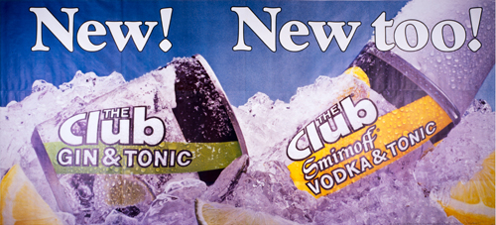
Why do people do things?
They are told to
They want to
Which is more effective?
Which is better?
JeffKoons.com
the ads reflected Koons’ desire to
“remove bourgeois guilt and shame in
responding to banality. I was telling the
bourgeois to embrace the thing that it
likes. Don’t divorce yourself from your true
being, embrace it.”
- from Tate Modern Jeff Koons Resource Pack
Why is this relevant?

Slide 4
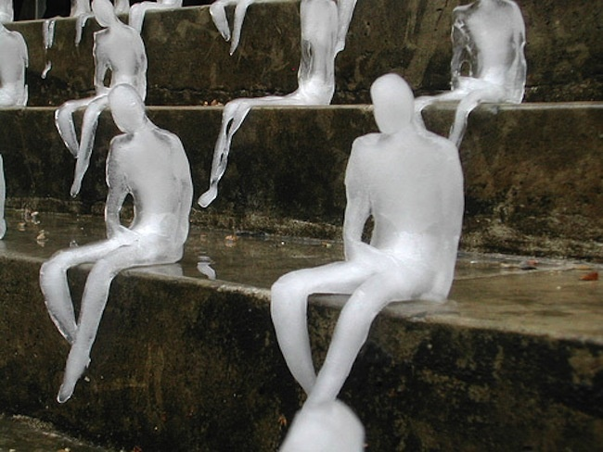
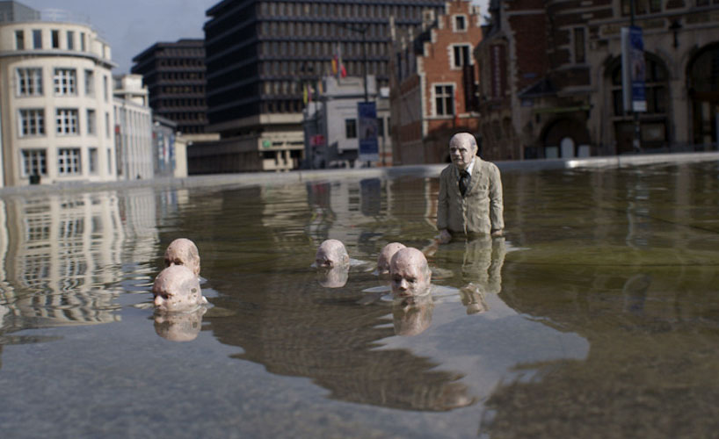
Global Warming
is bad.
Care about it.
ice sculptures, handcrafted
by Brazilian artist Nele Azevedo
The ‘Politicians Discussing Global Warming’ series, Isaac Cordal, Berlin 2011

Slide 5
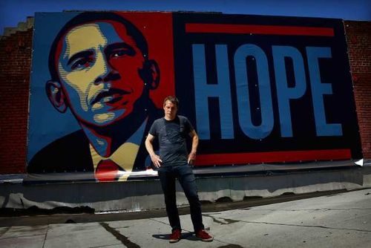
Art as branding
Sheppard Fairey. "Hope" poster supporting Barack Obama's 2008 presidential campaign
latimesblogs.latimes.com
Associated Press

Slide 6
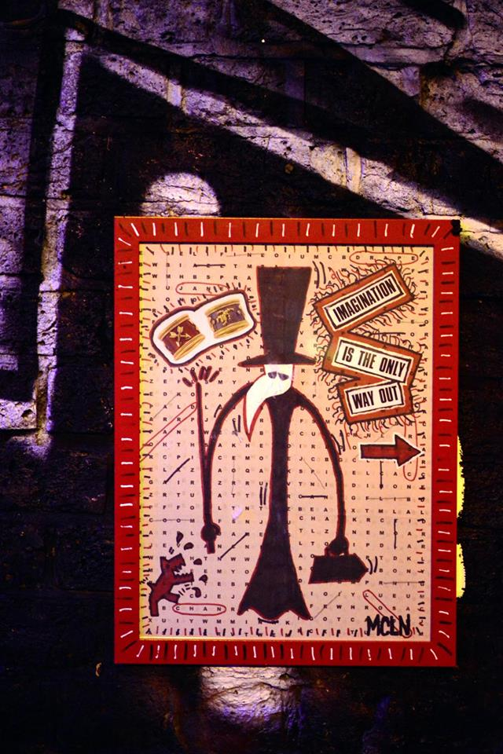
The Companies Act 2006
Articles of Association
of
ITSUP C.I.C.
OBJECTS, POWERS AND LIMITATION OF LIABILITY
Objects
The objects of the Company are to carry on activities which benefit the community and in particular (without limitation) to improving awareness of the social aims and benefits of urban art (including street art/installations and public art); develop platforms for artists to collaborate and improve their practice and relationships with communities; share and showcase developments in materials and techniques; improve public awareness, understanding and informed engagement in community issues; enhance the local recognition and ability of art to communicate on collective issues and opportunities for social improvements; contribute to social cohesion through culture; and improve the respect and quality of the contributions of urban art.
MCLN

Slide 7
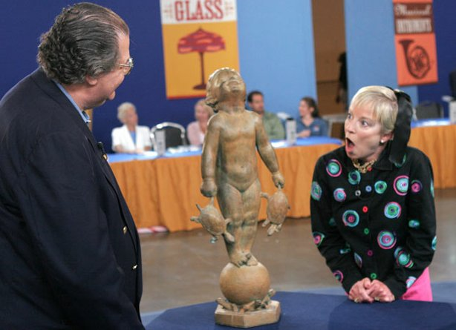
Longevity. Do we need it ?

Slide 8
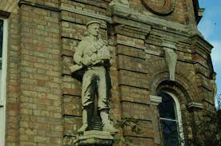
Public Sculpture
Stone and bronze: resist rain and frost, resist attack and theft.
Longevity of sculpture (public investment)
A sailor from the Boer war. Stonemason & architect Robert Bridgeman gave this statue to the city in 1905
thecityofsculpture.co.uk
Longevity of monument + memory
Image Source: Getty / GREGORIO CUNHA

Slide 9
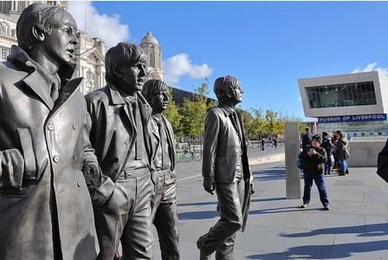
“Band, praised for ground-breaking originality, is
celebrated with 200 year old bronze technique.”
​Andy Edwards' Beatles sculpture finally unveiled

Slide 10
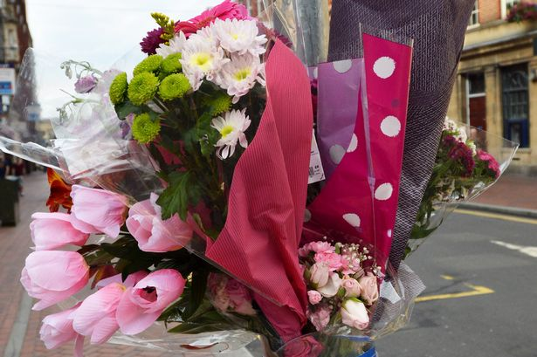
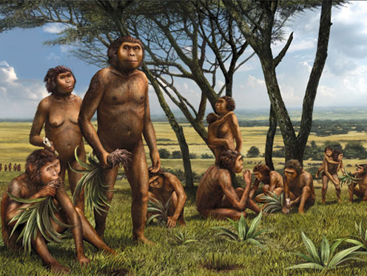
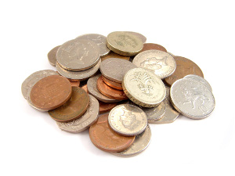
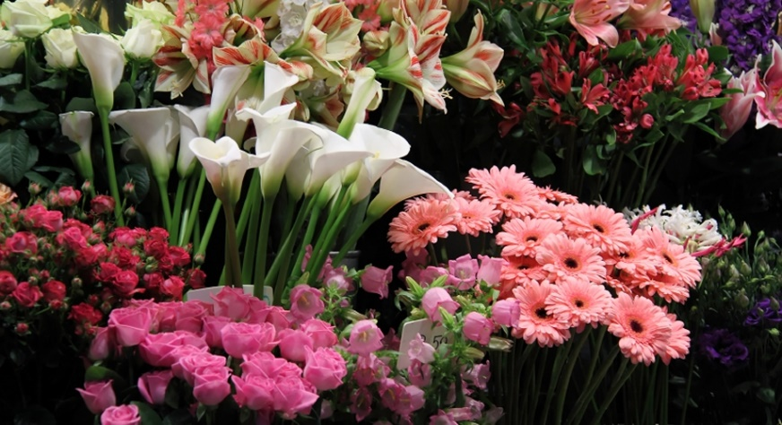
Choice of subject – who to celebrate?
+
+
→
Flowers : temporary, unofficial, and posted with belief…

Slide 11
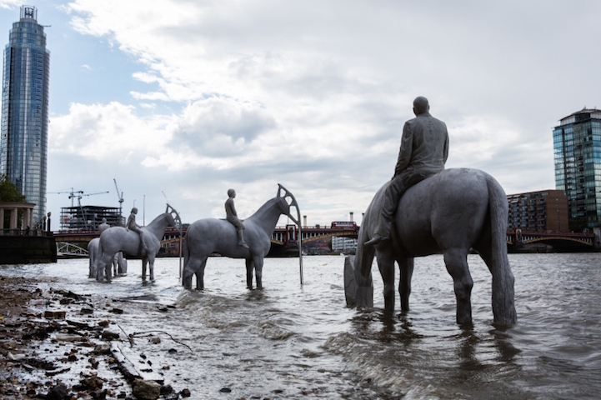
The Rising Tide, Jason deCaires Taylor
What can stone and bronze convey?
mass
form
light
detail
What have we forgotten, or forgiven, that they miss?
texture
colour
movement
location of space, and freedom (they are ground-based and static)
realism
life
Can sculpture do all that, and still be strong and durable?
mymodernmet.com

Slide 12
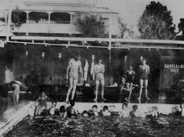
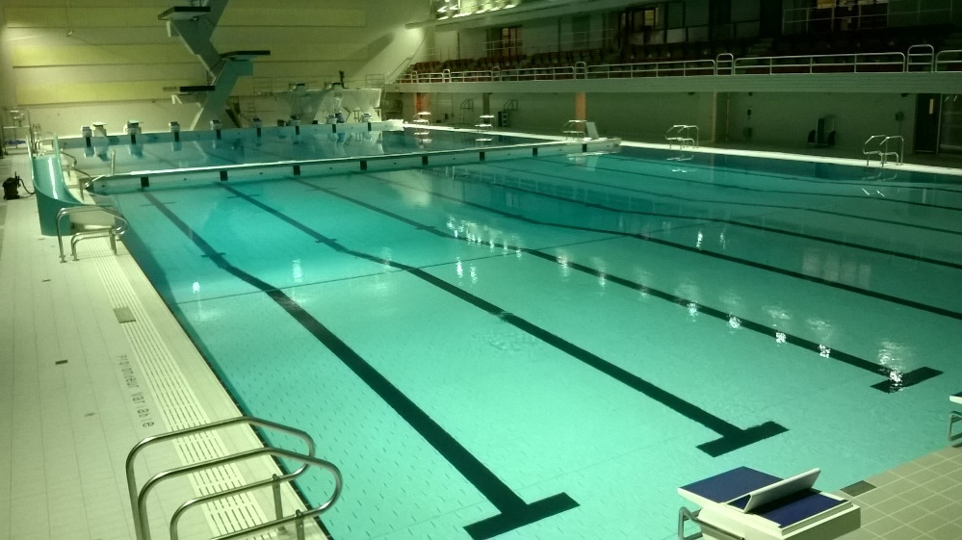
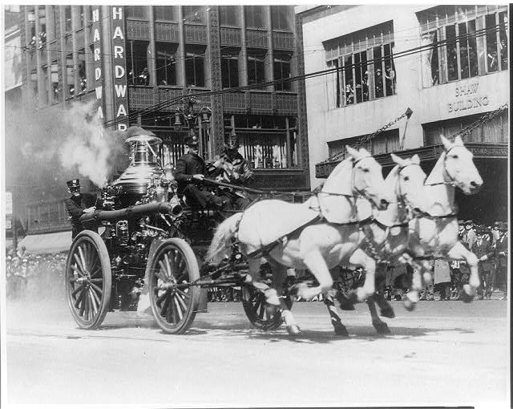
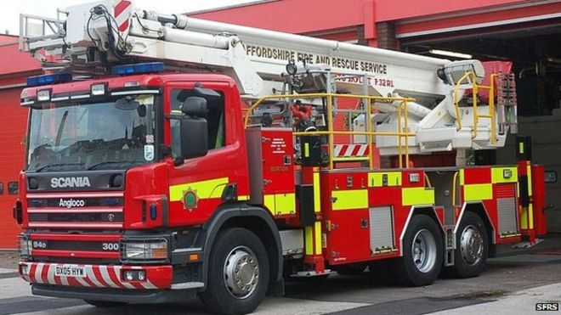
Public investment : technologies over the past 200 years
Is there anything that has not evolved ?
www.mustdobrisbane.com

Slide 13
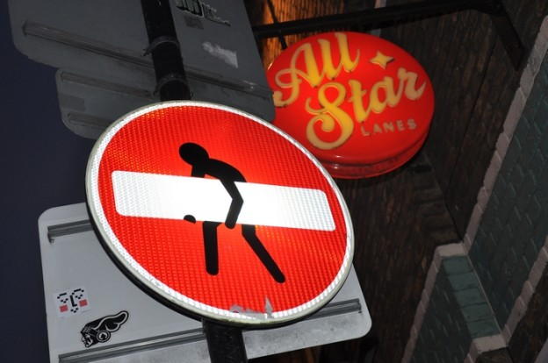
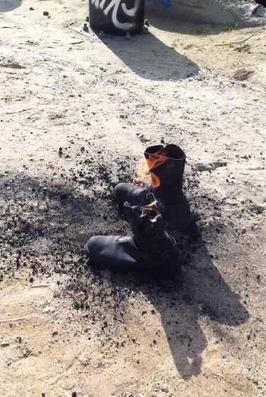
shoreditchstreetarttours.co.uk
Street art techniques
Quick and transportable. Lightweight + disposable: lifespan of buildings
Lifespan of urban sculpture
Artist as technician.
New techniques.
I’m blessed by not knowing what I’m doing, thus not knowing what’s impossible.

Slide 14
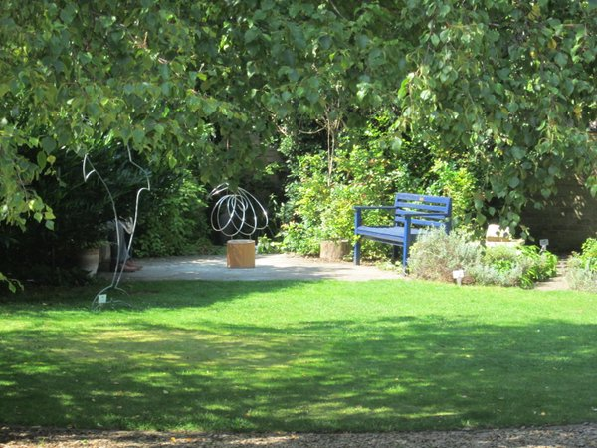
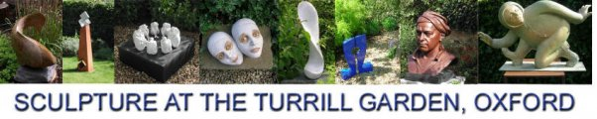
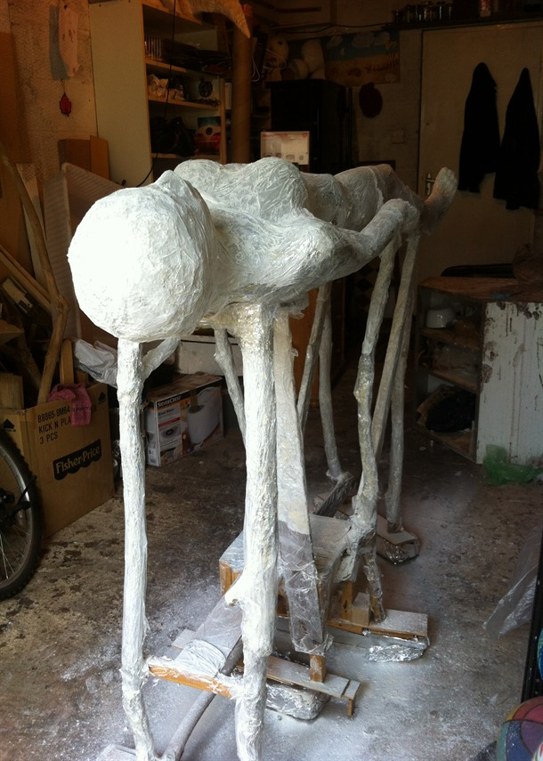
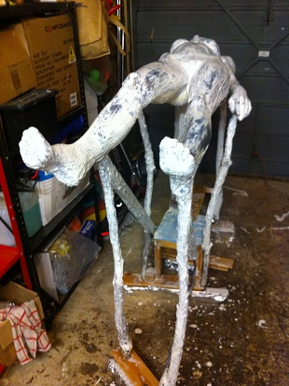
3Jun16 Private view. Exhibition 4-25Jun16
‘Flowerbed’

Slide 15
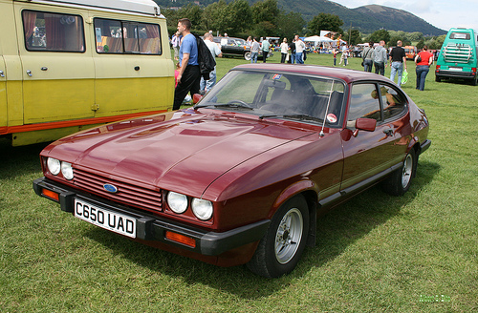
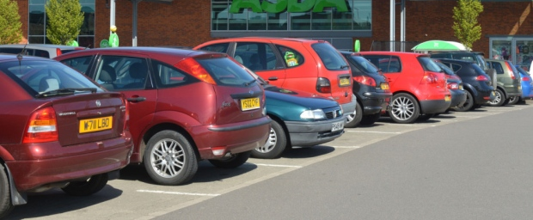
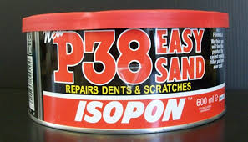
bestcarmag.com

Slide 16
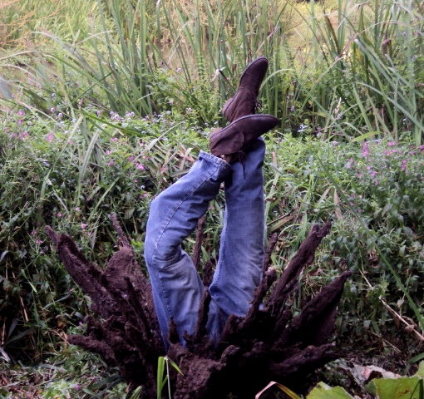
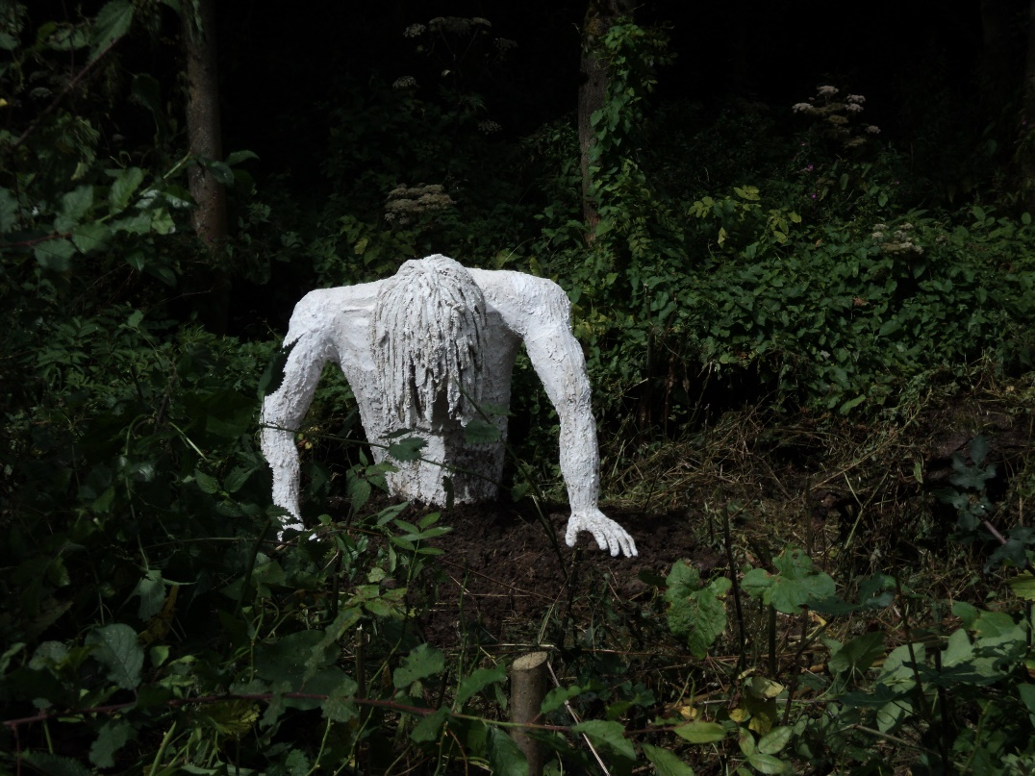
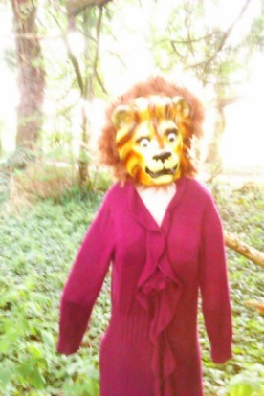
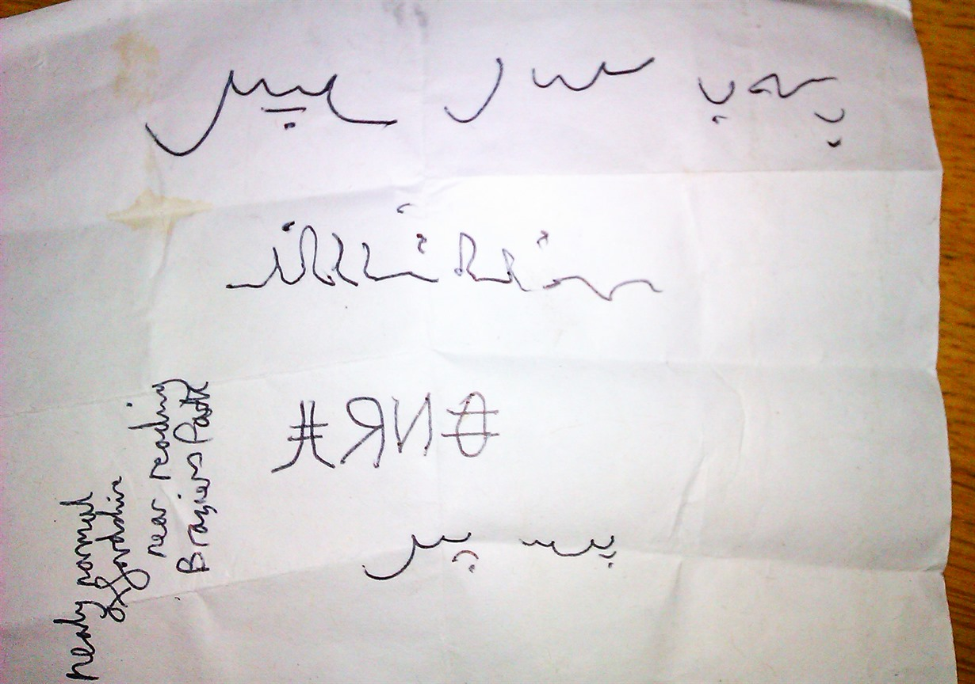
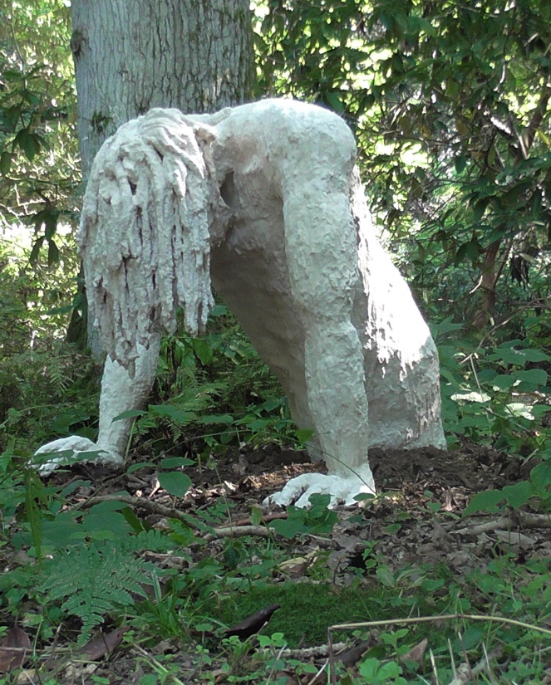
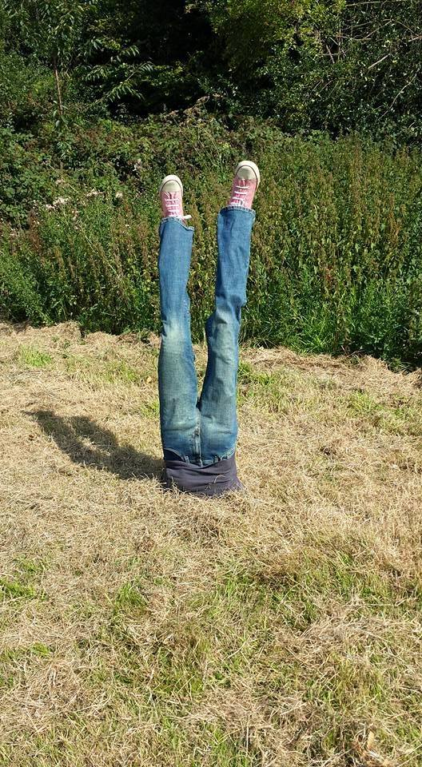
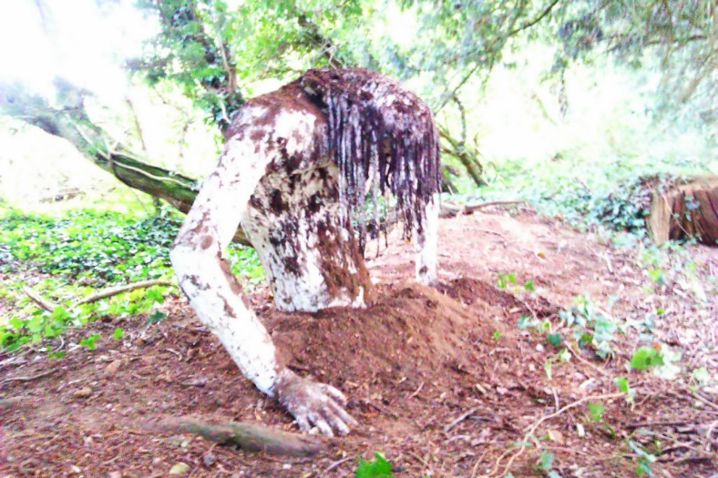
Pieces that are alive, get attention
Art gets reaction
Sculpture can make change
Carbon Innovation Programme with consultancy, 2016
Image courtesy of TheTwelveHourFoundation

Slide 17
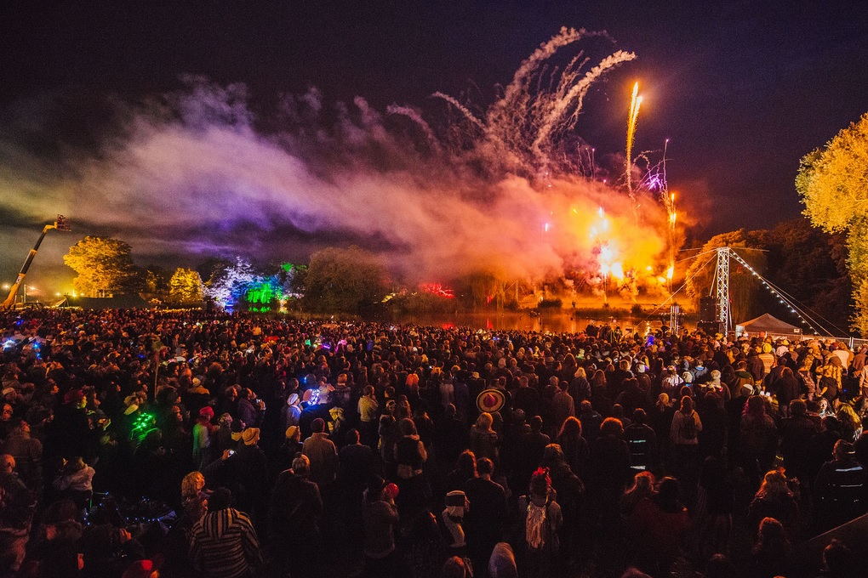
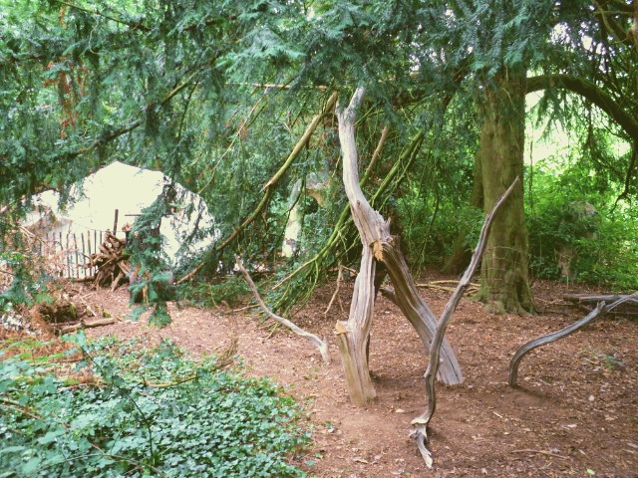
Started 1½ years ago
Shambala Supernormal
Tribe of Hermits Tribal Tree
coincidentally next to the resident hermit

Slide 18
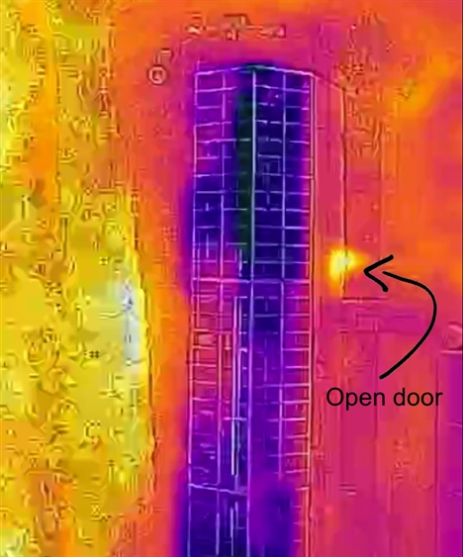
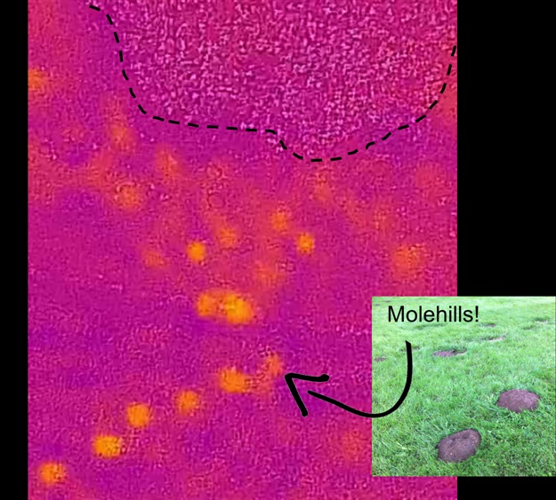
Drone based thermal imaging camera Images courtesy of Dr Russ Layberry

Slide 19
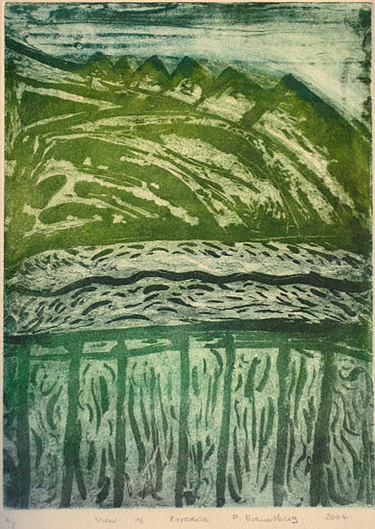
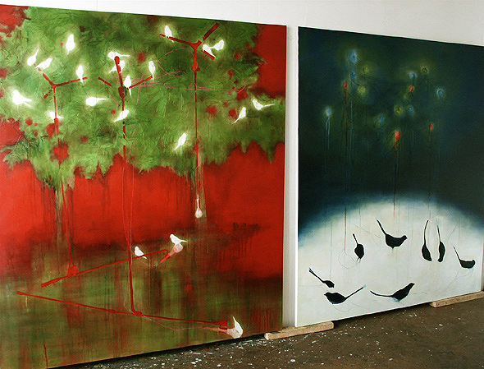
Like People
‘the Tree’ and ‘the Cluster’
oil and thread stitched/canvas
Faye Phimister
‘Paradise’
David Braunsberg 2004
http://davidbraunsberg.co.uk
re-title.com/artists/Faye-Phimister2.asp
http://nealmoonstone.wix.com

Slide 20
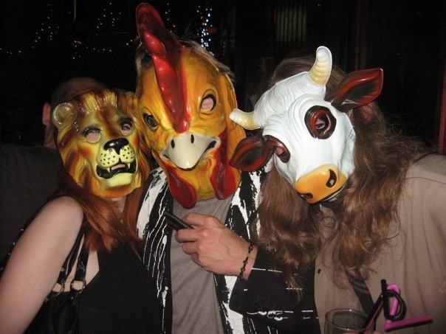
The ‘No offence’ module (now ended)

Slide 21
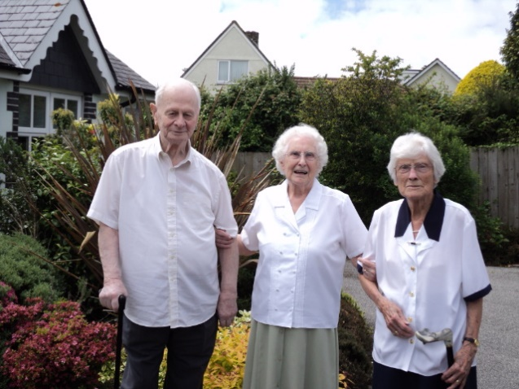
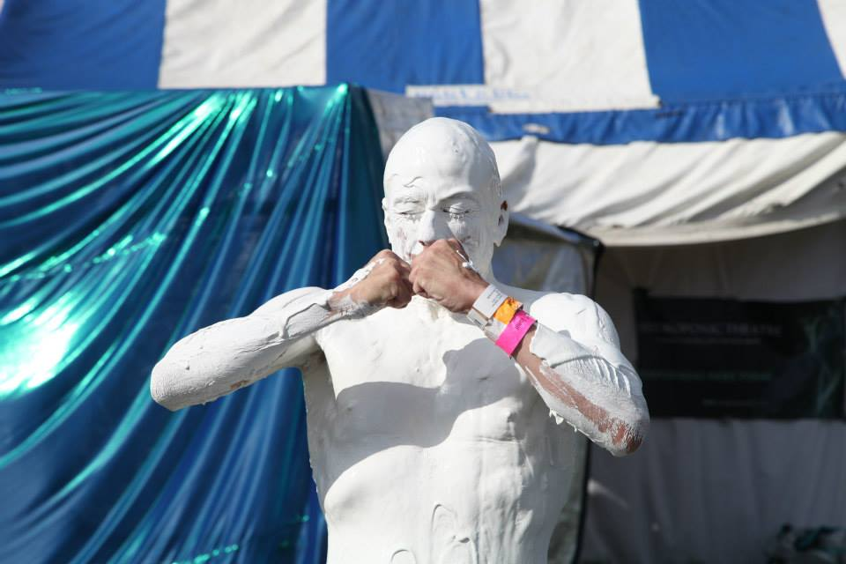



The course was
temporary
We are temporary
Circularity is good
Life’s a
wonderful
thing.
One of the best things there is !”

Slide 22







image courtesy of P.Coronai
image courtesy of Jamie de Dodger
The Nest Stage
Supernormal Fest 2012-2015
image courtesy of JRKane
How did mud make a rainbow?
image courtesy of Melita Dennett
image courtesy of The Fish Police
image courtesy of Talkaoke.com

Slide 23









Thank you folks.
Any Questions?

